Slide 1
Know Yourself to lead Yourself:
Transforming your leadership with MBTI®
Leaders by Design
January 2018
Nicole Pinkham
Lead Senior Training Consultant
SummaSource at
Auburn University at Montgomery
334.318.4504

Slide 2

Notes:
Today’s Accelerator starts in the PQ Circle we will apply the learning to the other two -

Slide 3

THE CORE
IQ
COMPETENCY
EQ
CONNECTIVITY
THE
CORE
PQ
SELF-AWARENESS
© GiANT WORLDWIDE, Source: Inspired by Travis Bradberry & Jean Greaves, Emotional Intelligence 2.0
Notes:
Today’s Accelerator starts in the PQ Circle we will apply the learning to the other two -

Slide 4
DRIVERS THAT AFFECT YOUR BEHAVIOR
NATURE
LEADERSHIP
BEHAVIORS
NURTURE
CHOICE

Slide 5
THE OUGHTS AND SHOULDS OF “NURTURE”
ROLE MODELS
SCHOOLING
FAITH
GENDER
OUGHTS &
SHOULDS
CULTURE
SUCCESSES
PARENTING
FAILURES
AUTHORITY FIGURES
DREAMS
EARLY LIFE EXPERIENCES
Notes:
We may have the same Nature by wiring but we are all unique as no two individuals ever makes the same choices or grow up with the same Nurture.

Slide 6

KNOW YOURSELF TO LEAD YOURSELF
CONSEQUENCES
KNOW
YOURSELF
LEAD
YOURSELF
REALITY
ACTIONS
(PATTERNS)
TENDENCIES
© GiANT WORLDWIDE

Slide 7

Transformational Leadership
Creates valuable and positive change in followers with the end goal of developing followers into leaders.

Slide 8
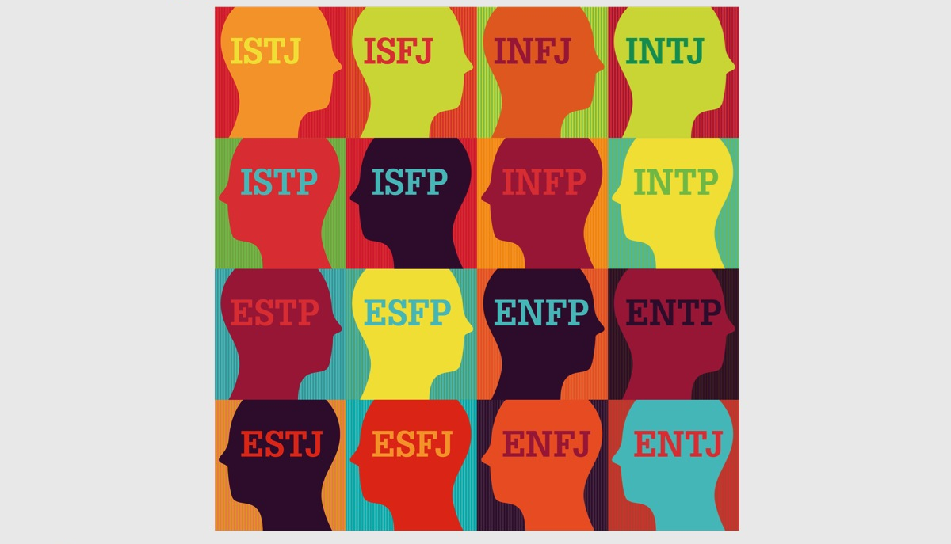

Slide 9
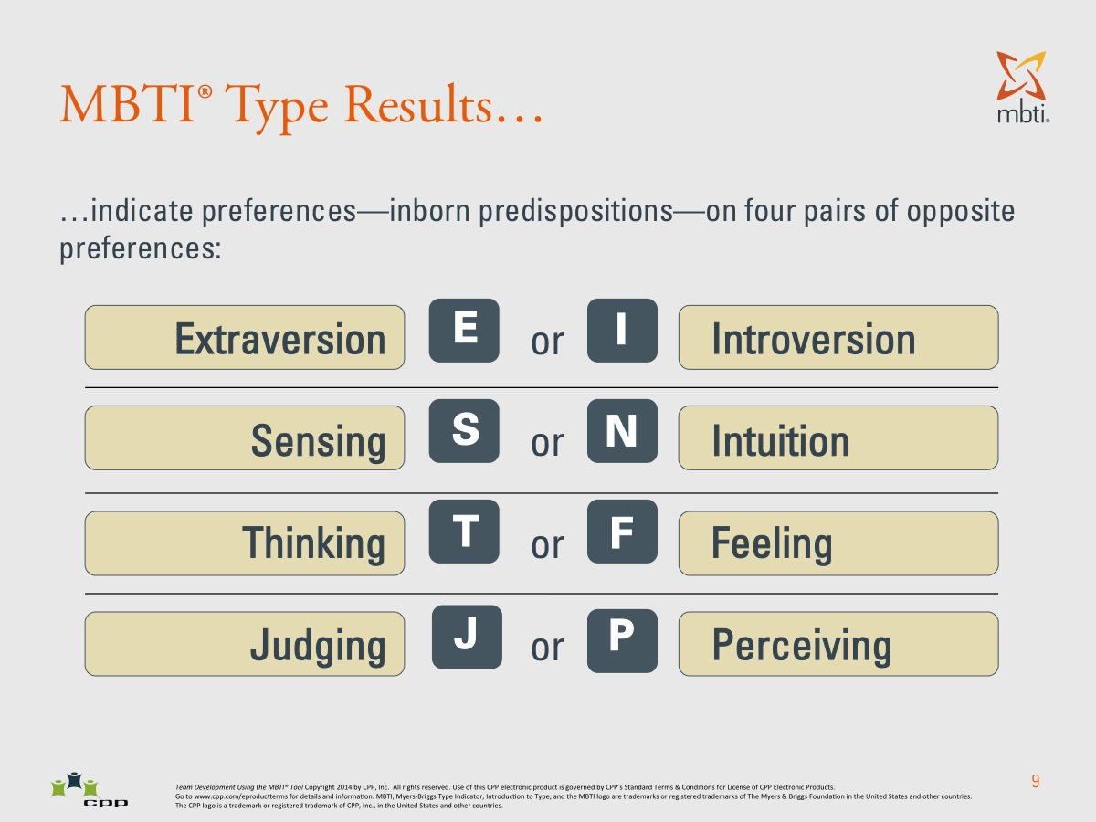

Slide 10
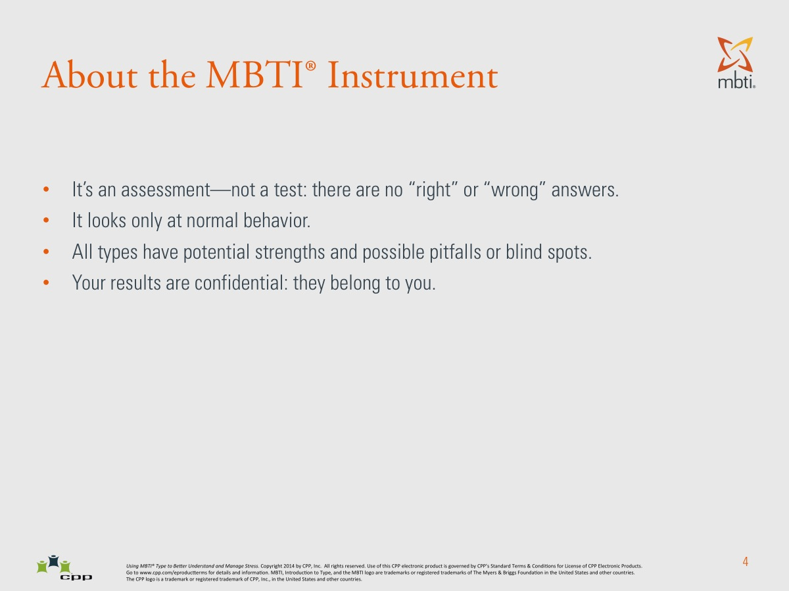

Slide 11
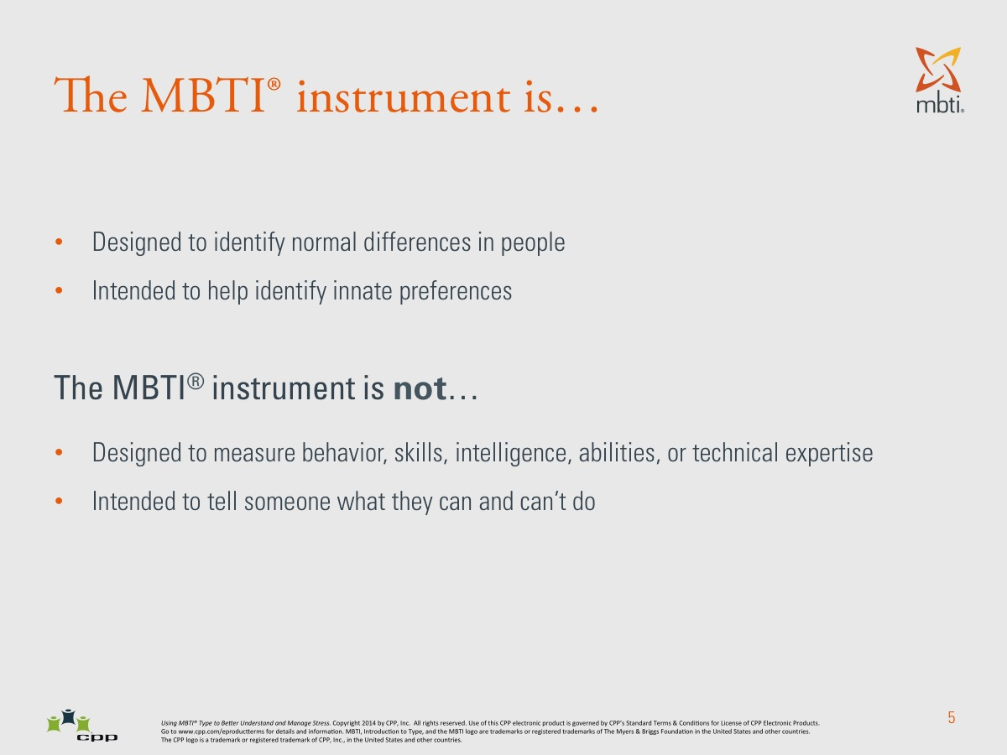

Slide 12
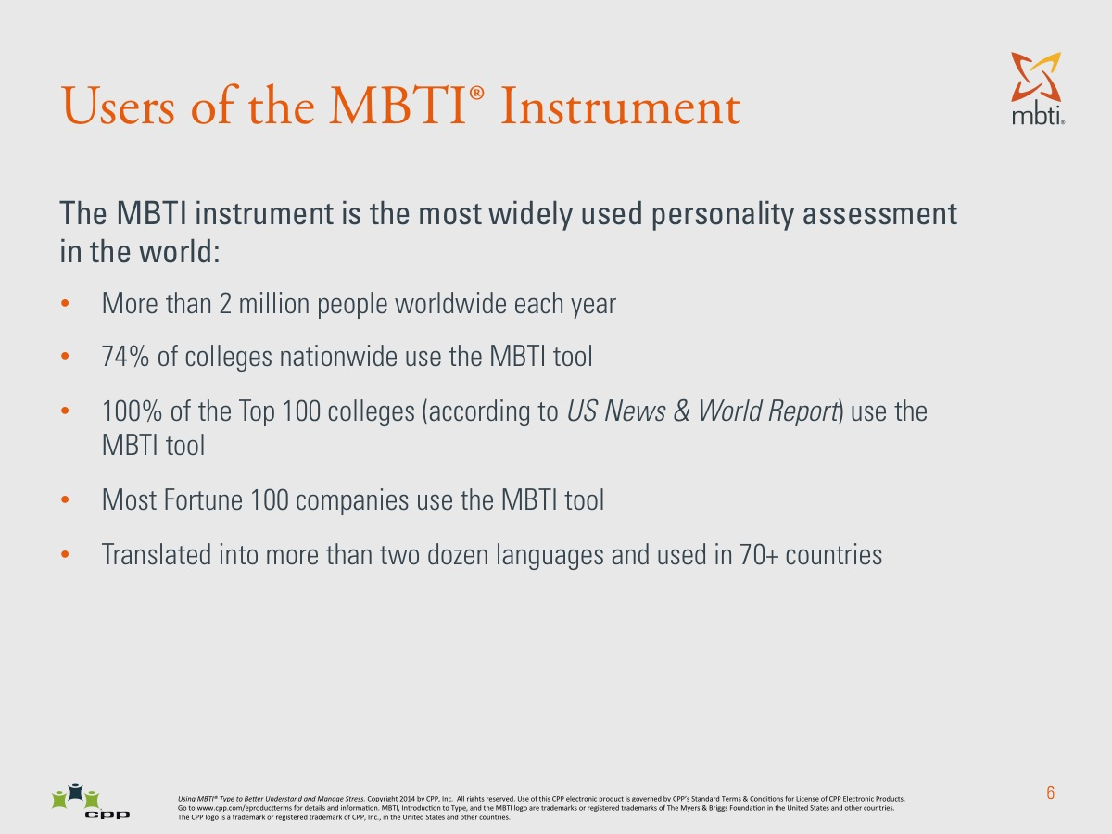

Slide 13
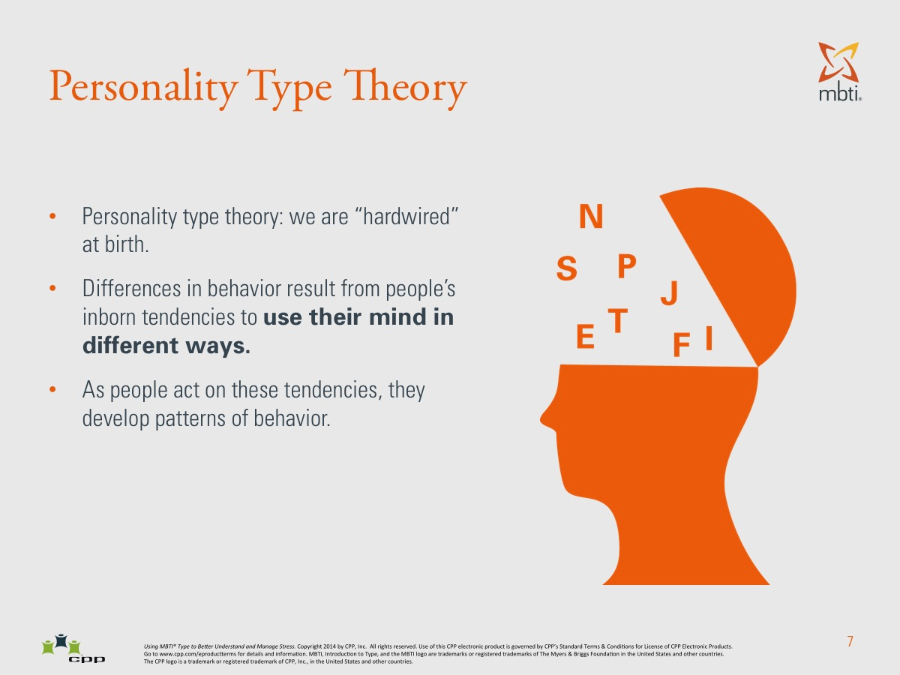

Slide 14
Levels of Confidence
“Best-fit” type
Reported type
Self-estimated type
True type—innate predispositions

Slide 15
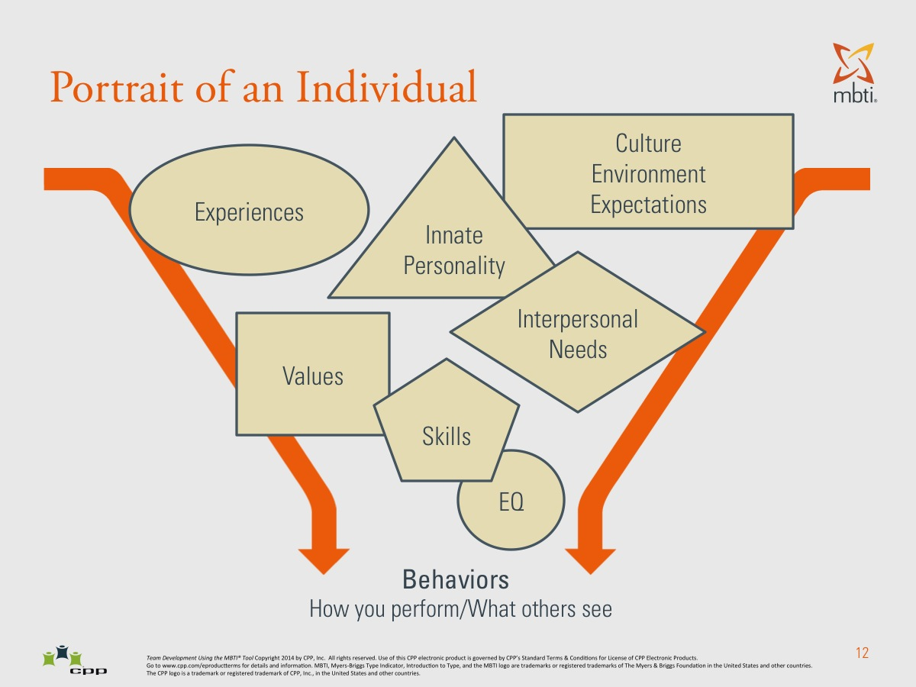

Slide 16
Questions to Consider
Why are some people excited by change while others find it overwhelming and draining?
Why do some people want to jump into implementation while others want to reflect and think through it first?
Why do some people want to know the details, specifics and steps involved while others want only the big picture and long-term goals?
Why do some people focus on the tasks to be done while others focus on the effects on and needs of the people involved?
Why do some people want plans with time lines while others want flexibility and fun?

Slide 17
Who Are YOU?
What are your strengths?
What are your blind spots?
What areas do you need to improve to lead with greater effectiveness?

Slide 18
LEADERSHIP AND MBTI®
In what area do I need to stretch the most?

Slide 19
Type Dynamics
First Function (Dominant)
Second Function (Auxiliary)
Third Function (Tertiary)
Fourth Function (Inferior)

Slide 20
Type Dynamics
People who prefer Extraversion express their favorite function outwardly.
People who prefer Introversion keep their favorite function inwardly, expressing their second function outwardly.

Slide 21
Type Dynamics
ESFP & ESTP – Dominant Extraverted Sensing
ENTP & ENFP – Dominant Extraverted Intuition
ISTJ & ISFJ – Dominant Introverted Sensing
INFJ & INTJ – Dominant Introverted Intuition
ESTJ & ENTJ – Dominant Extraverted Thinking
ESFJ & ENFJ – Dominant Extraverted Feeling
ISTP & INTP – Dominant Introverted Thinking
ISFP & INFP – Dominant Introverted Feeling

Slide 22
TYPE DEVELOPMENT AND LEADERSHIP DEVELOPMENT
The Specialist Years (see pages 12-13)
    Favorite function – teens and twenties
    Second function – late teens through thirties
The Generalist Years
  Third function – Twenties through forties
  Fourth process – Forties through Sixties
Dual-Mindedness

Slide 23
Your Leadership Map
CONTEXT
Mindset
Viewpoints
Beliefs
RESULTS
Skills
Competencies
Abilities
Behaviors
Style
Who you are
What you bring
Habits of behavior
LEARNING LOOP

Slide 24
“A good leader inspires others
with confidence in him;
a great leader inspires them
with confidence in themselves.”
--unknown

Slide 25
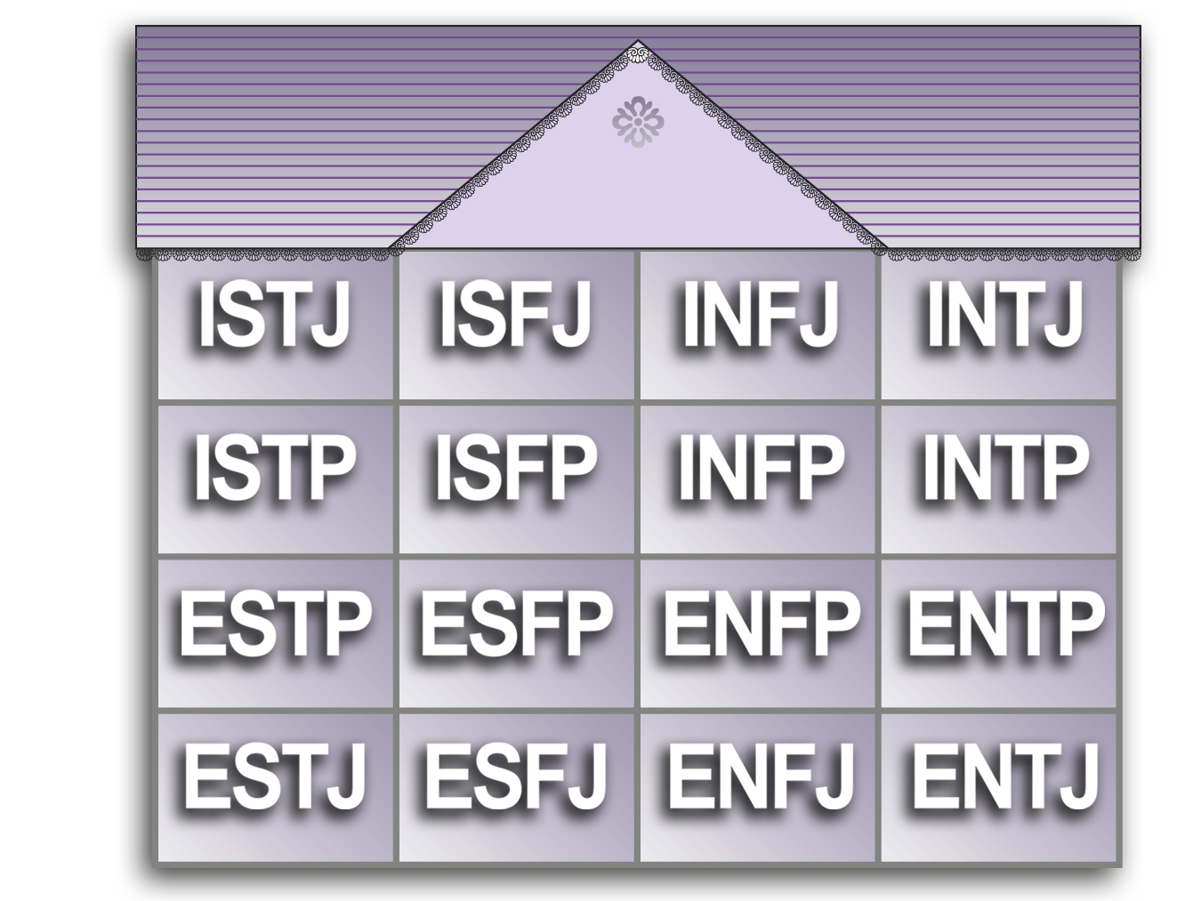
16-Room House

Slide 26
MBTI and STRESS
In the GRIP

Slide 27
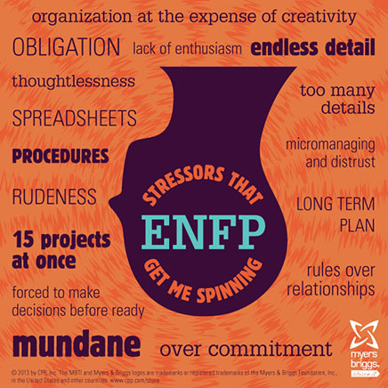

Slide 29
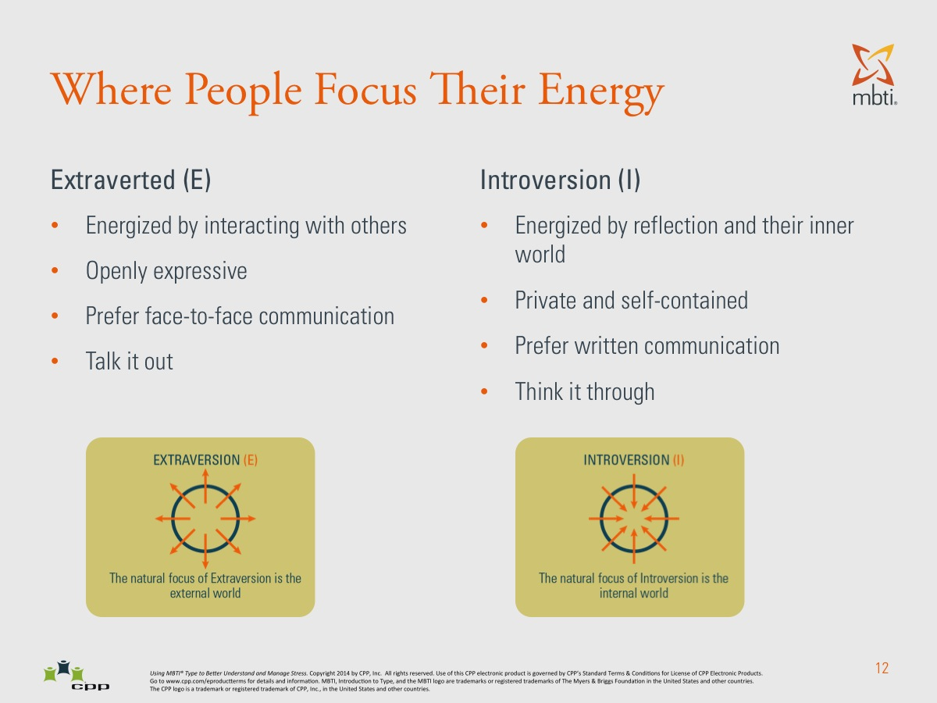

Slide 30
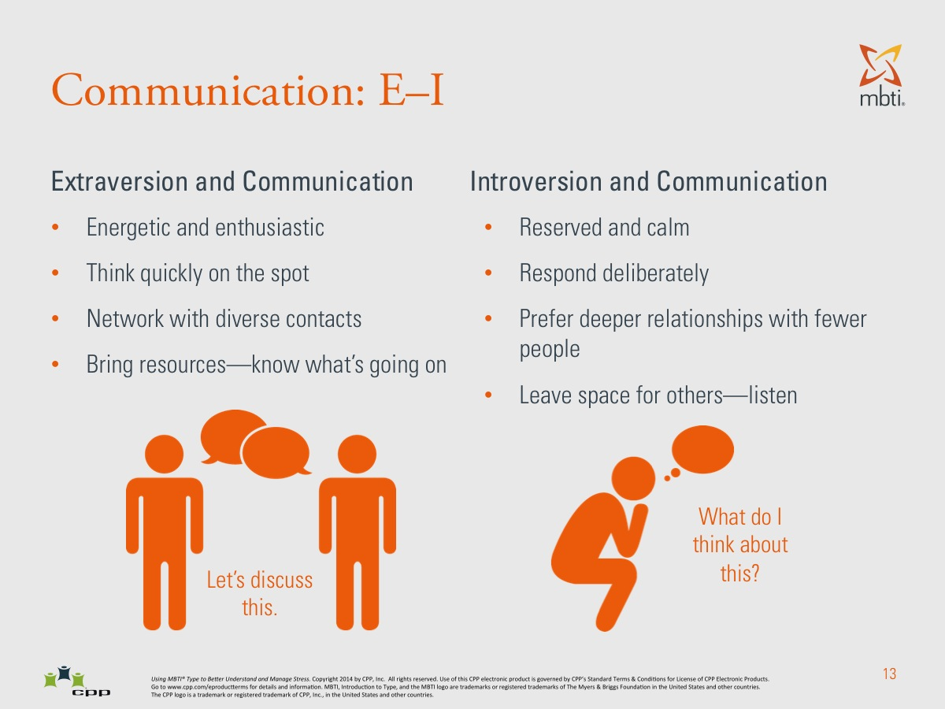

Slide 31
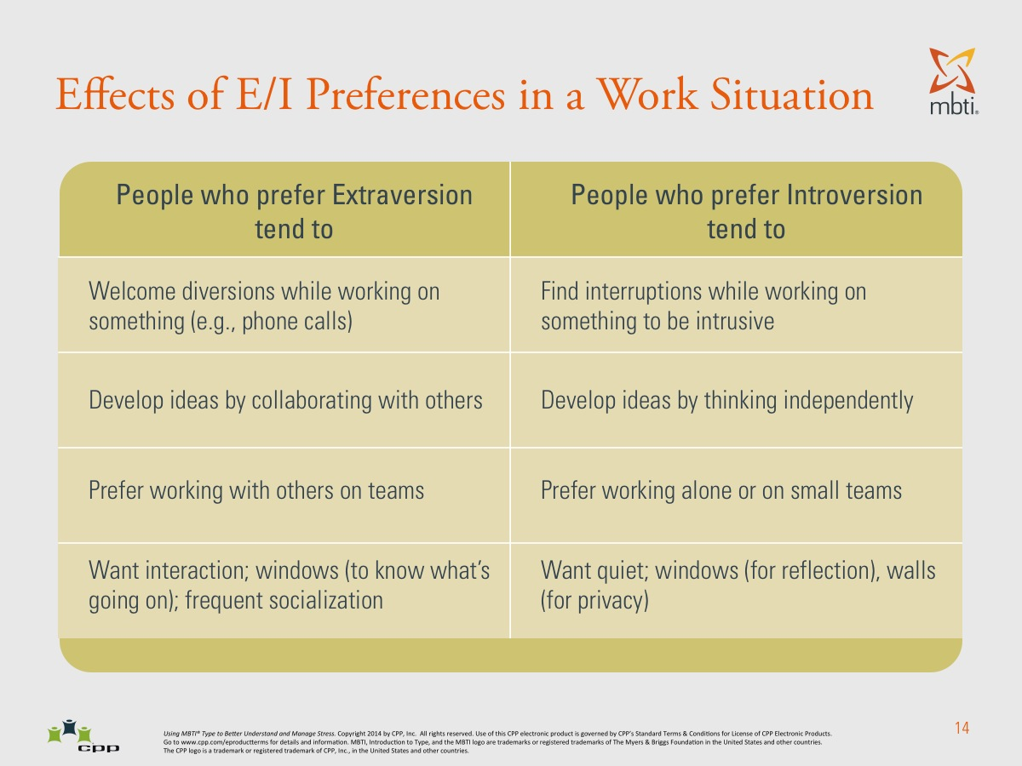

Slide 32
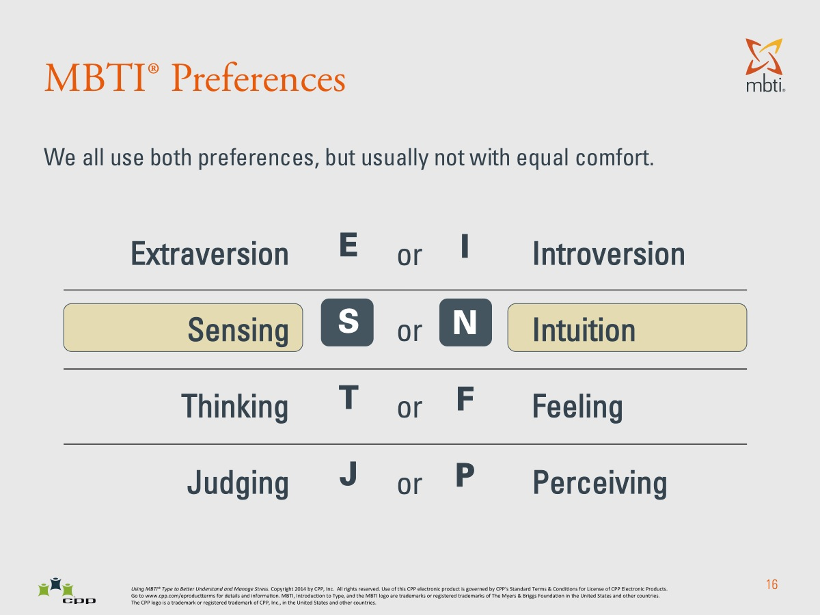

Slide 33
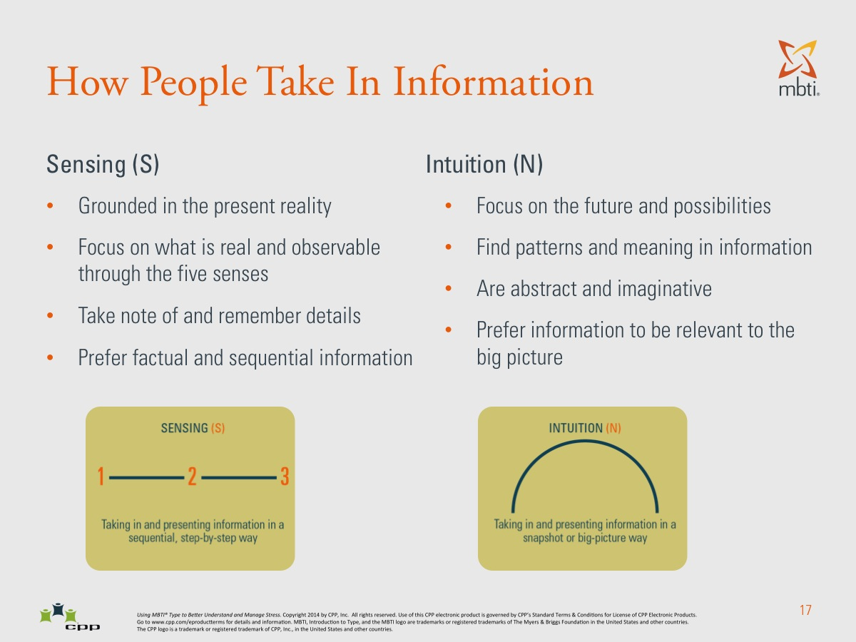

Slide 34
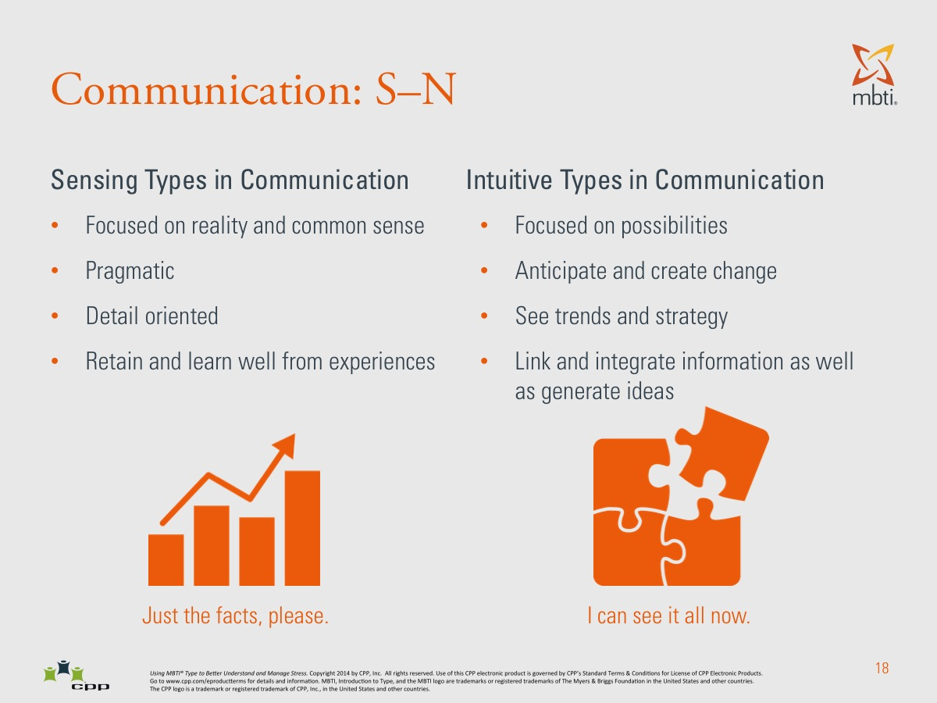

Slide 35
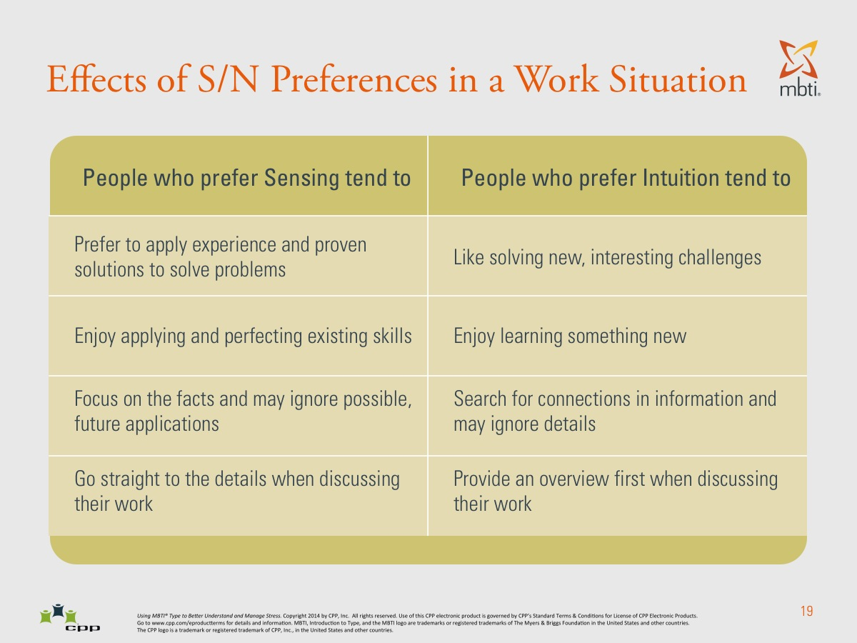

Slide 36
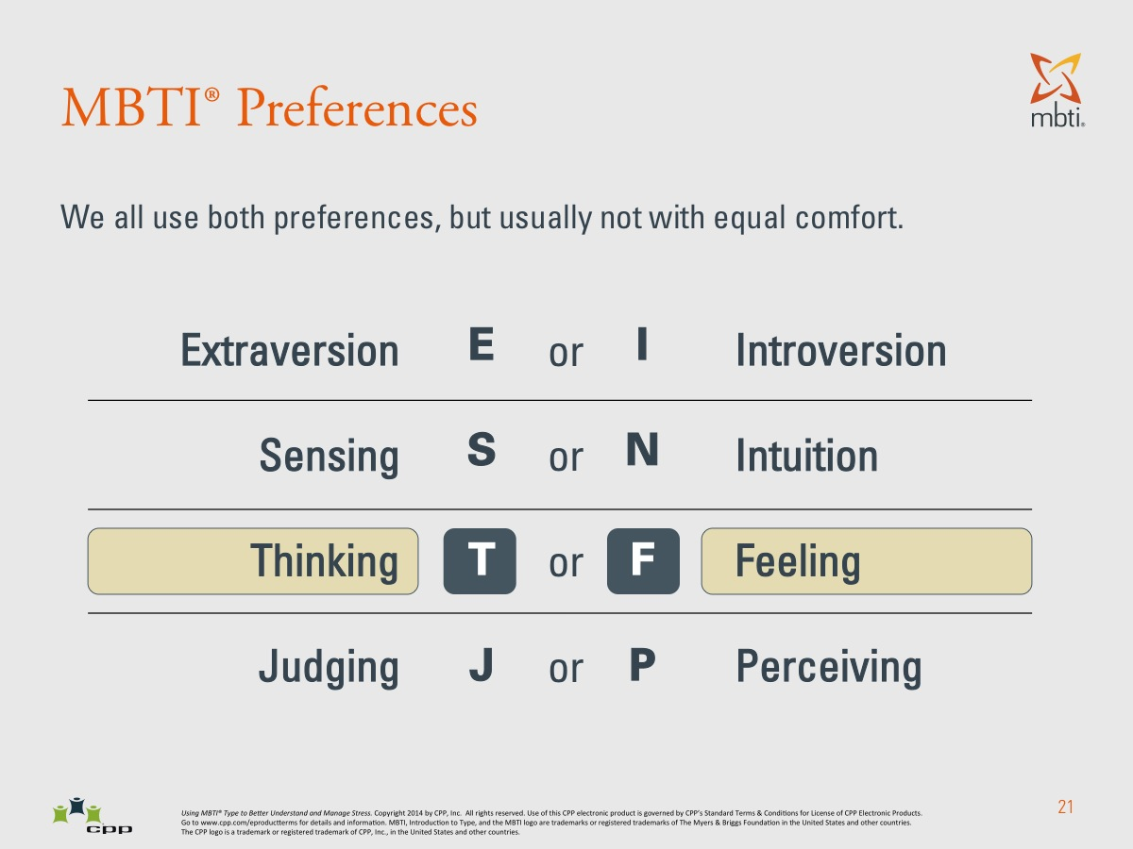

Slide 37
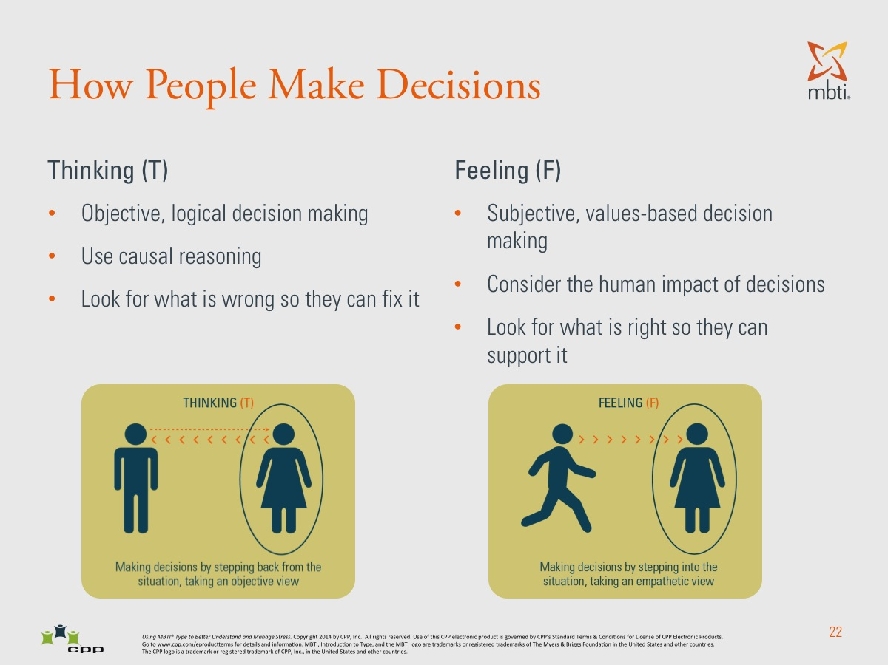

Slide 38
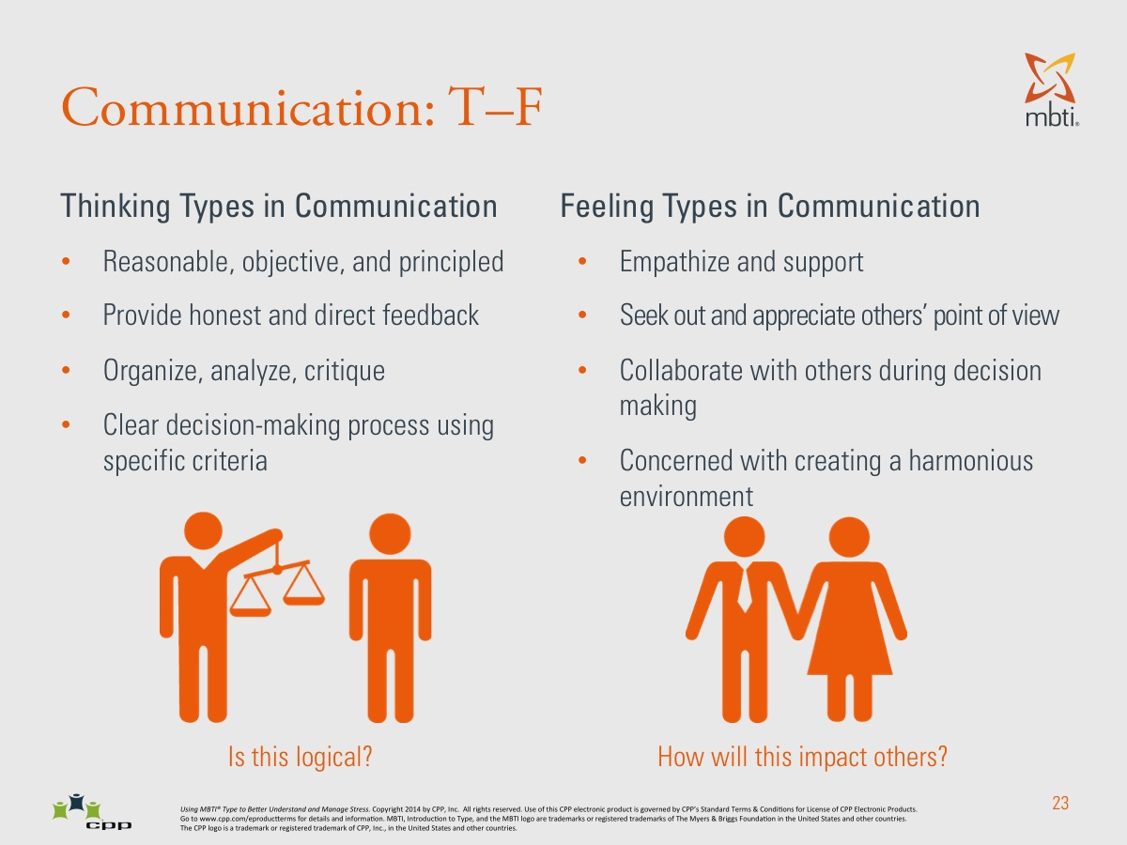

Slide 39
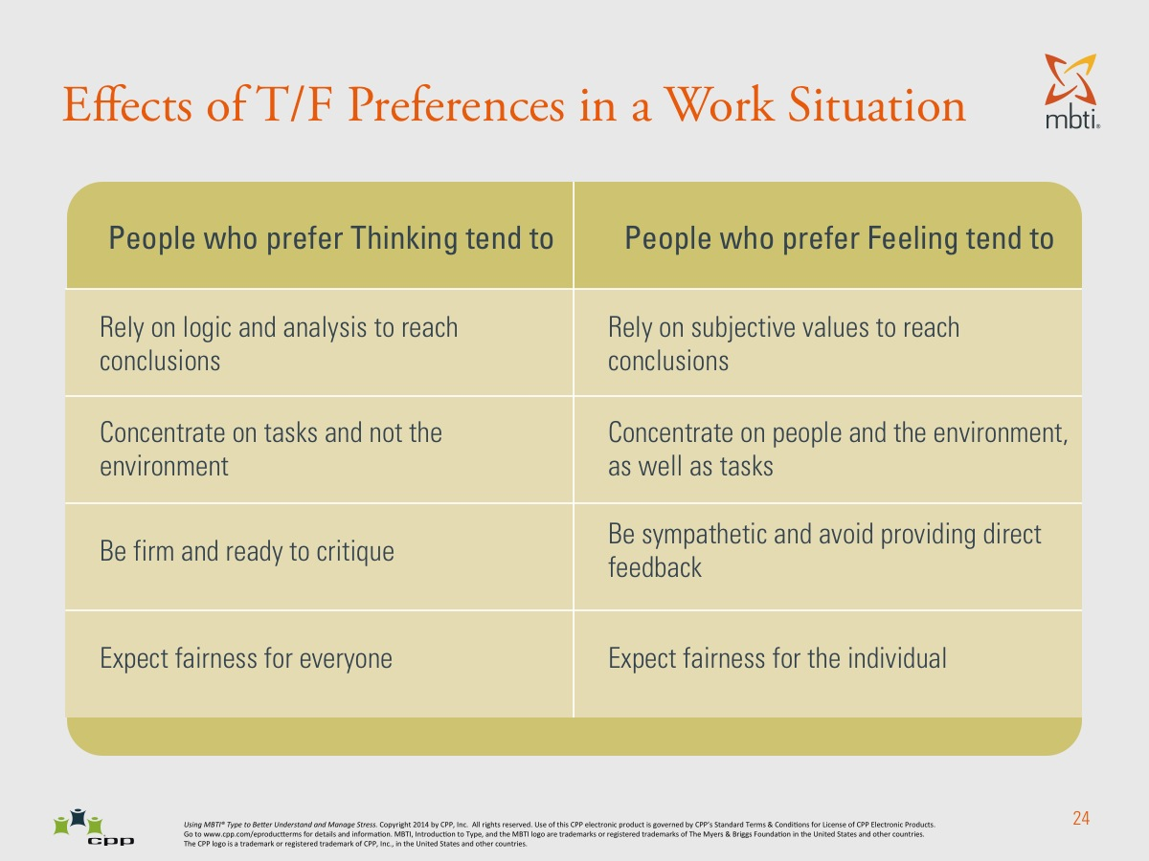

Slide 40
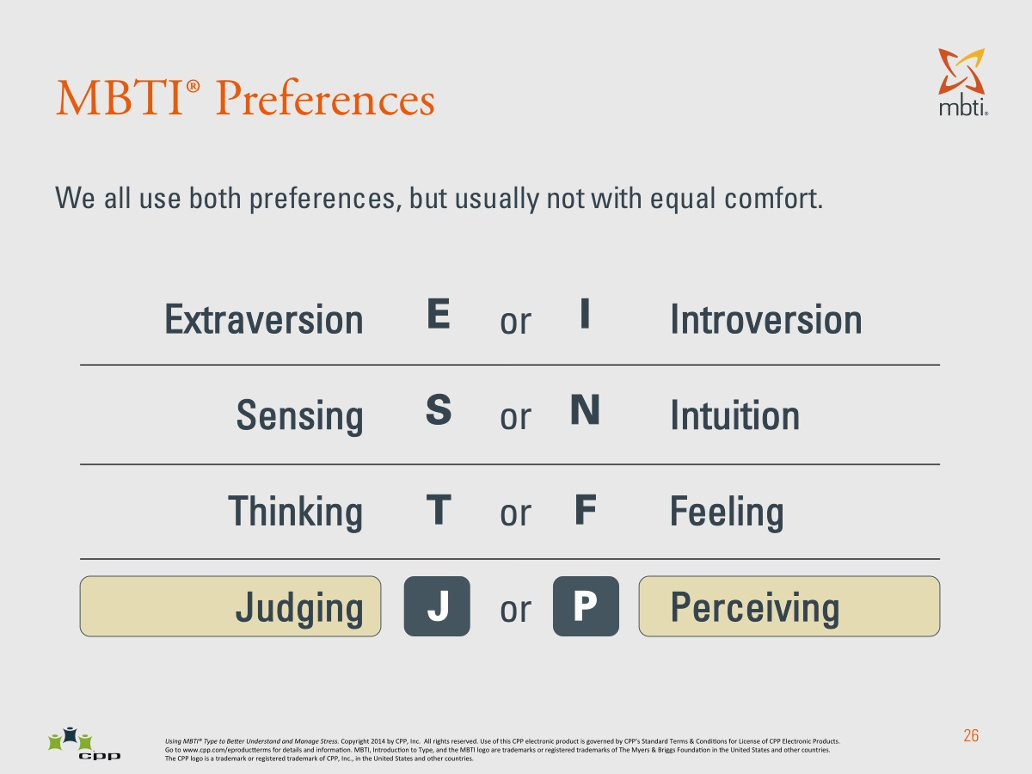

Slide 41
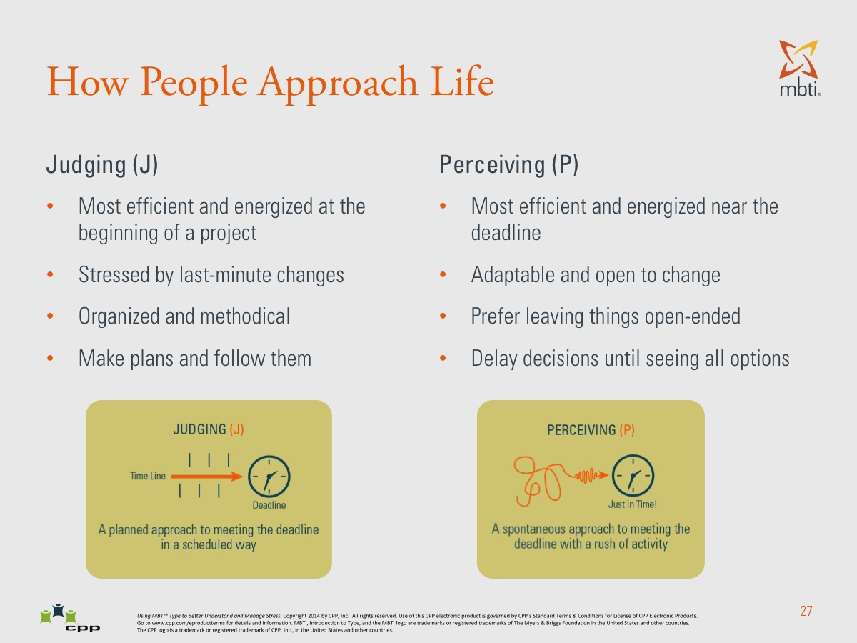

Slide 42
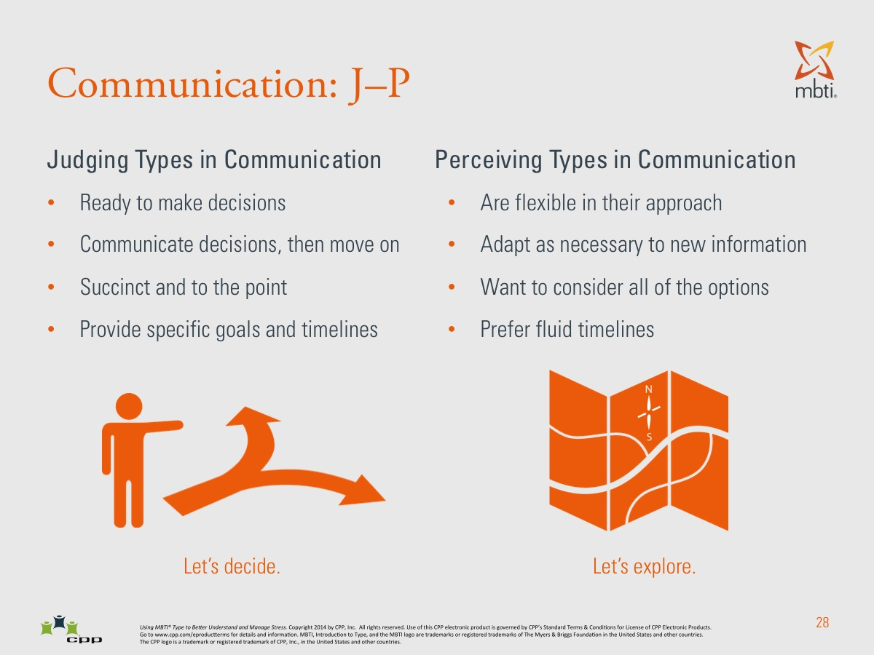

Slide 43
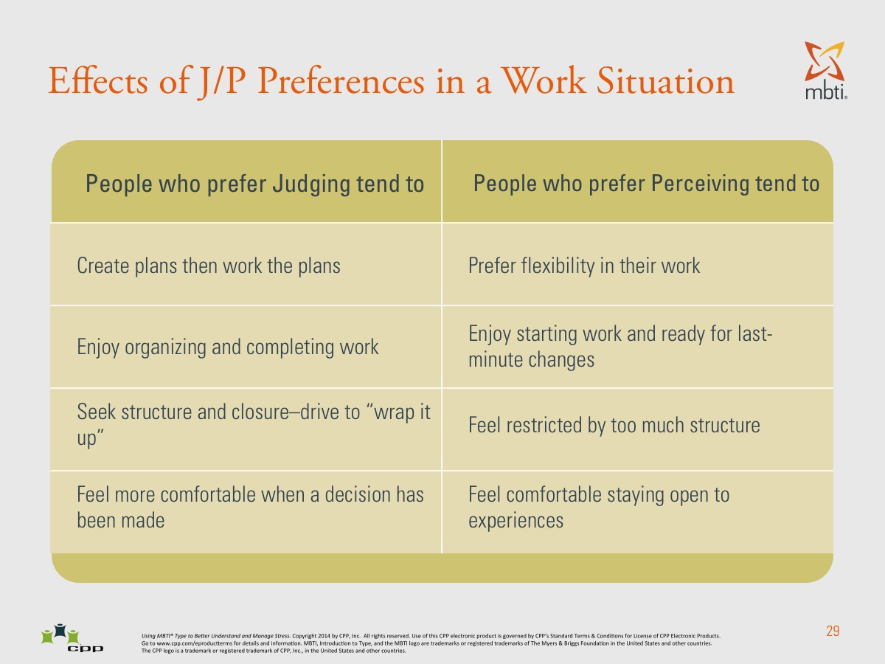

Slide 44


Slide 45
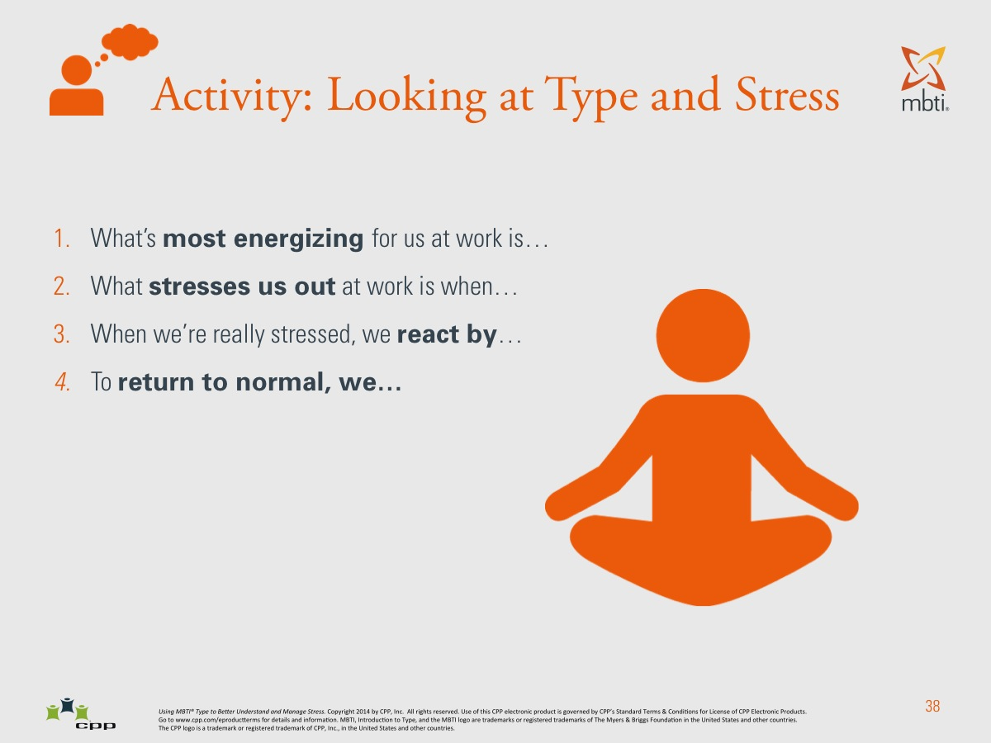

Slide 46
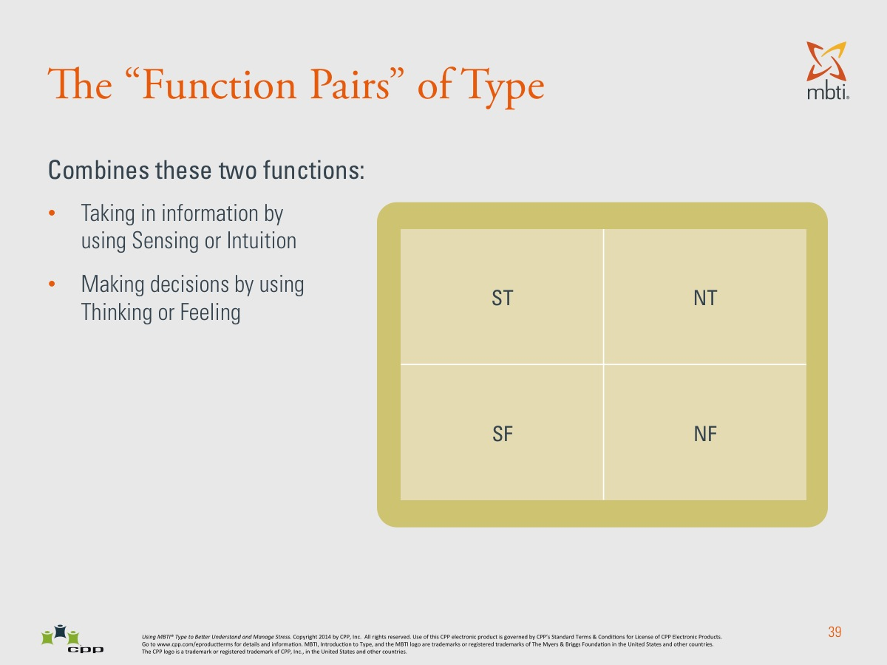

Slide 47
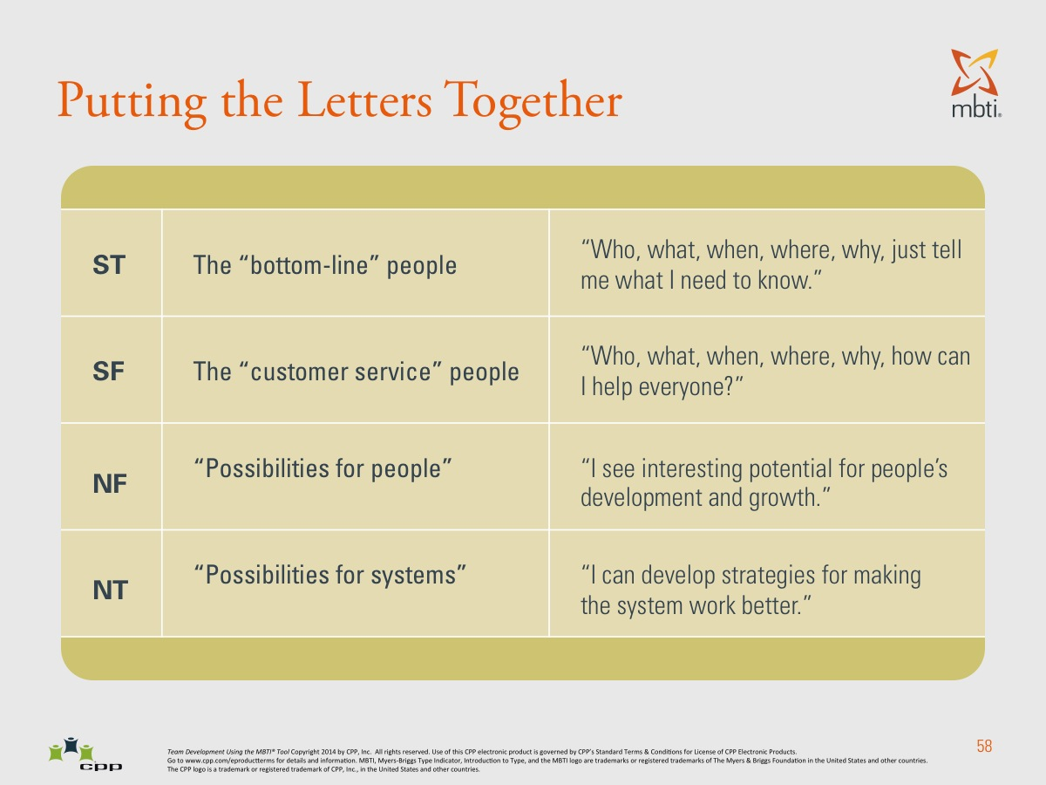

Slide 48
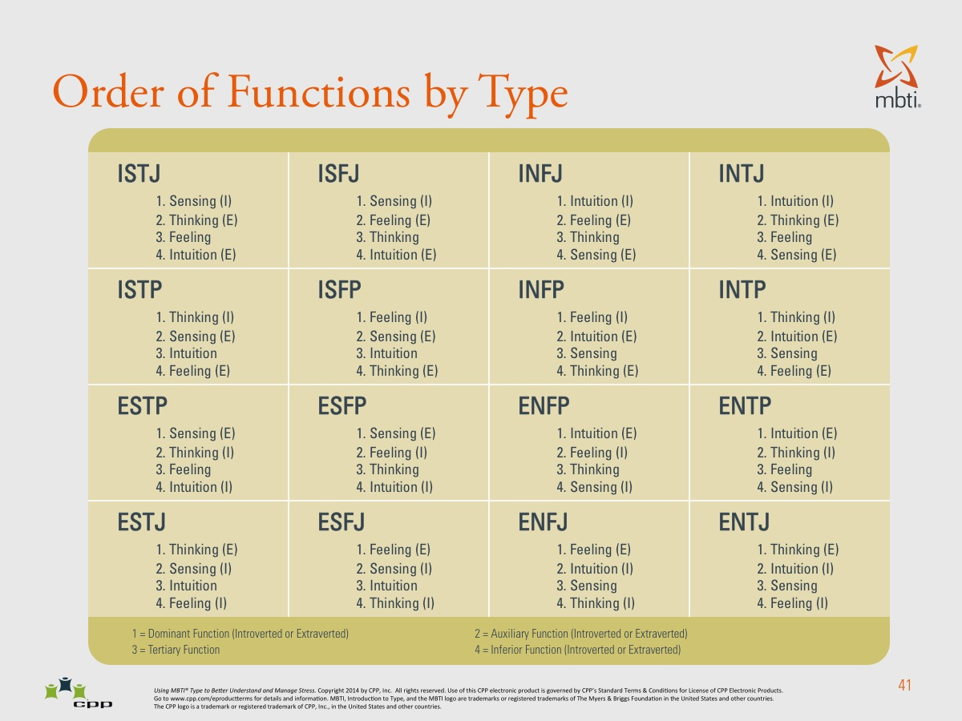

Slide 49
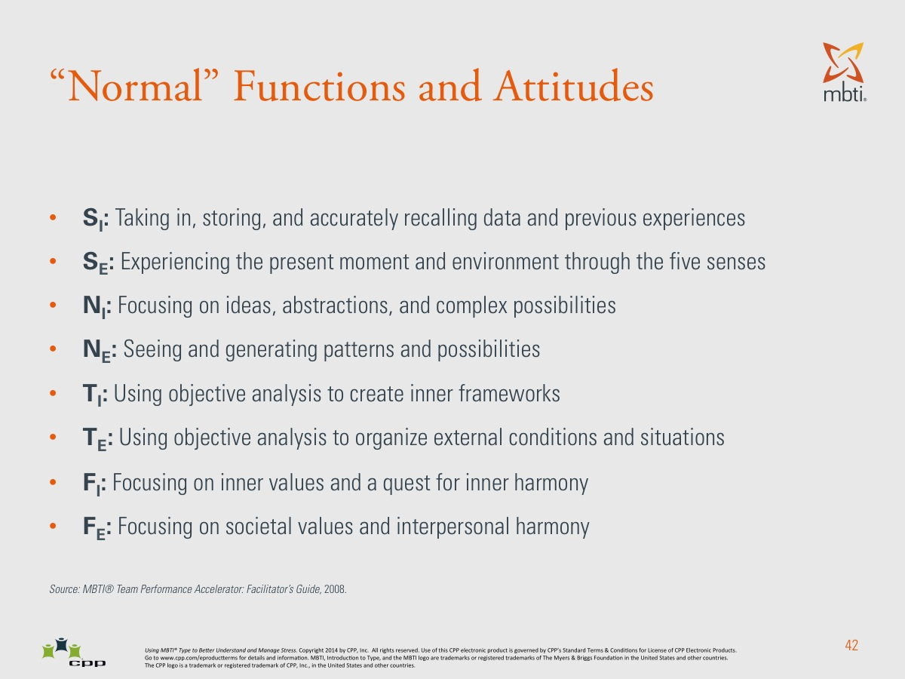

Slide 50
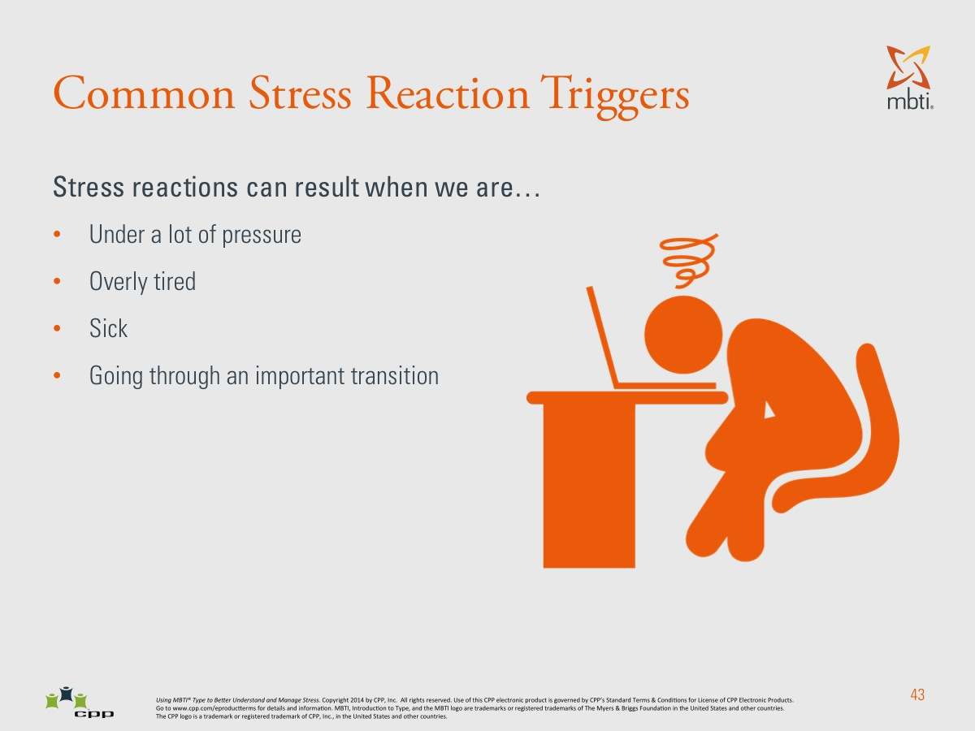

Slide 51
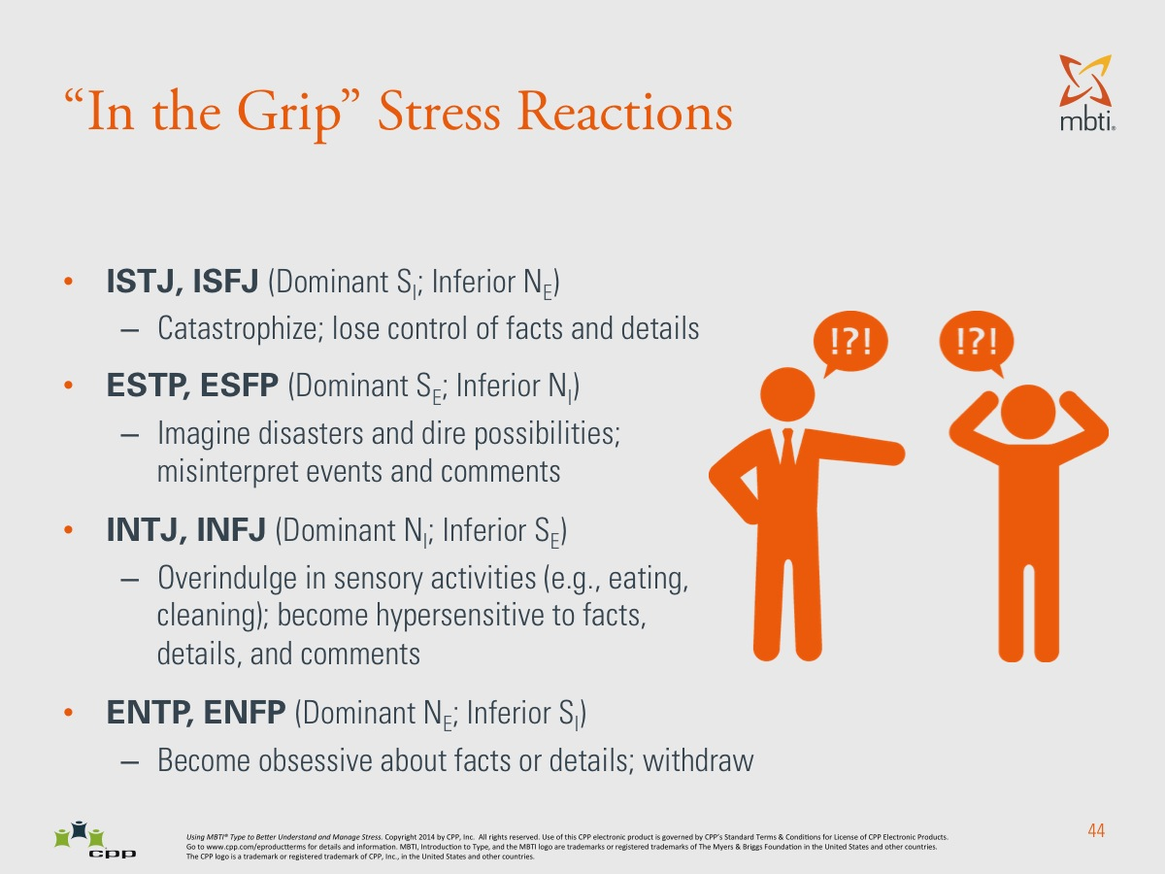

Slide 52
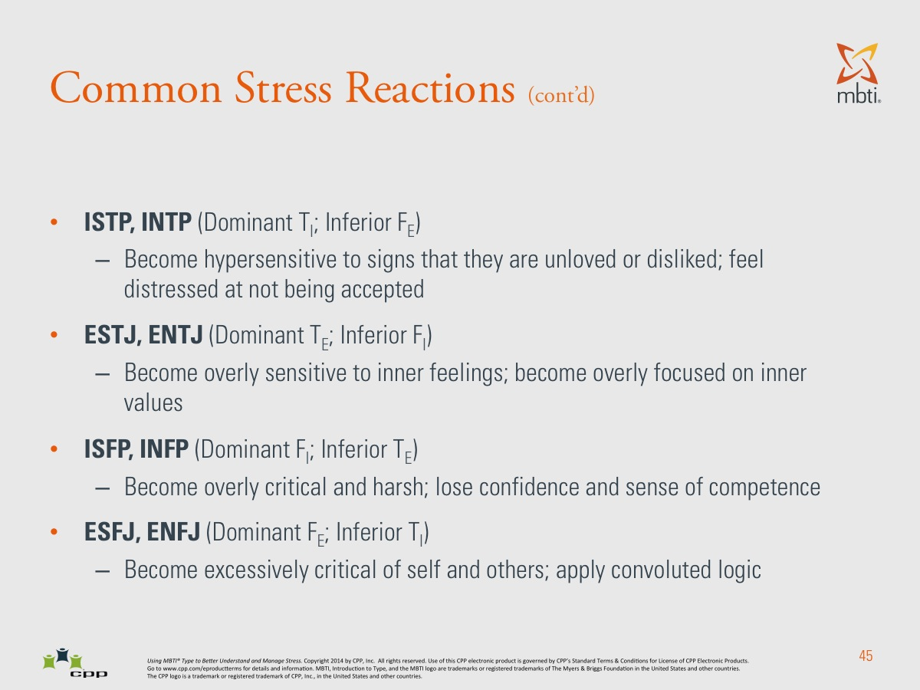

Slide 53
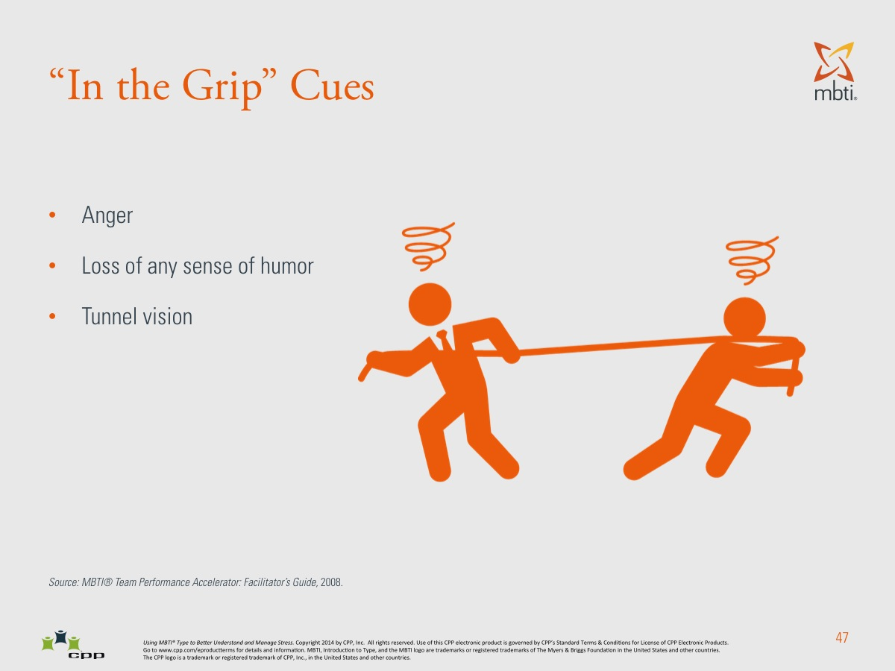

Slide 54
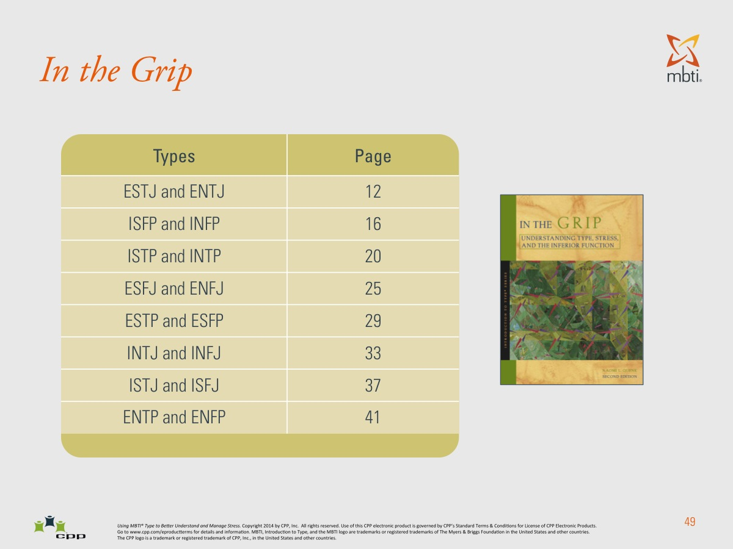

Slide 55
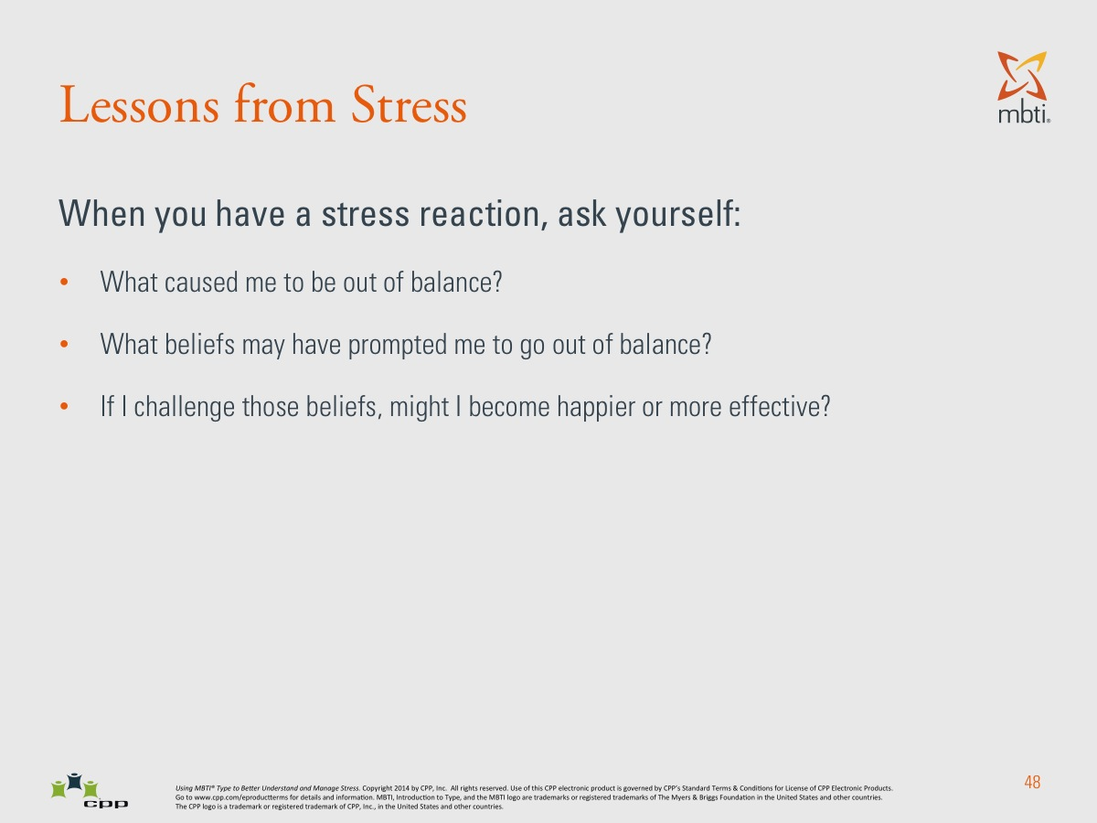

Slide 56
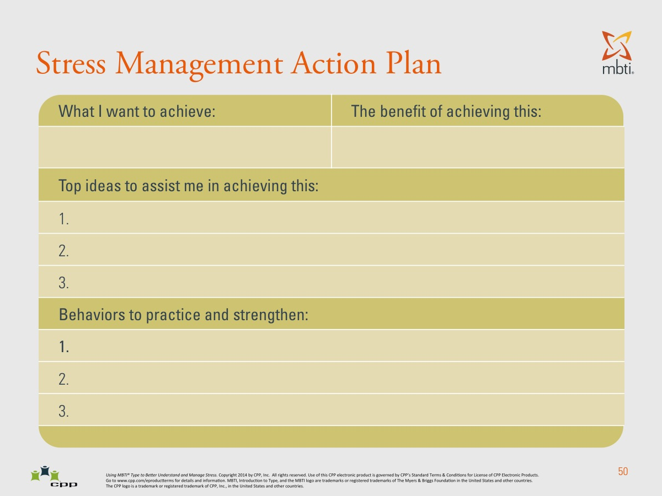

Slide 57
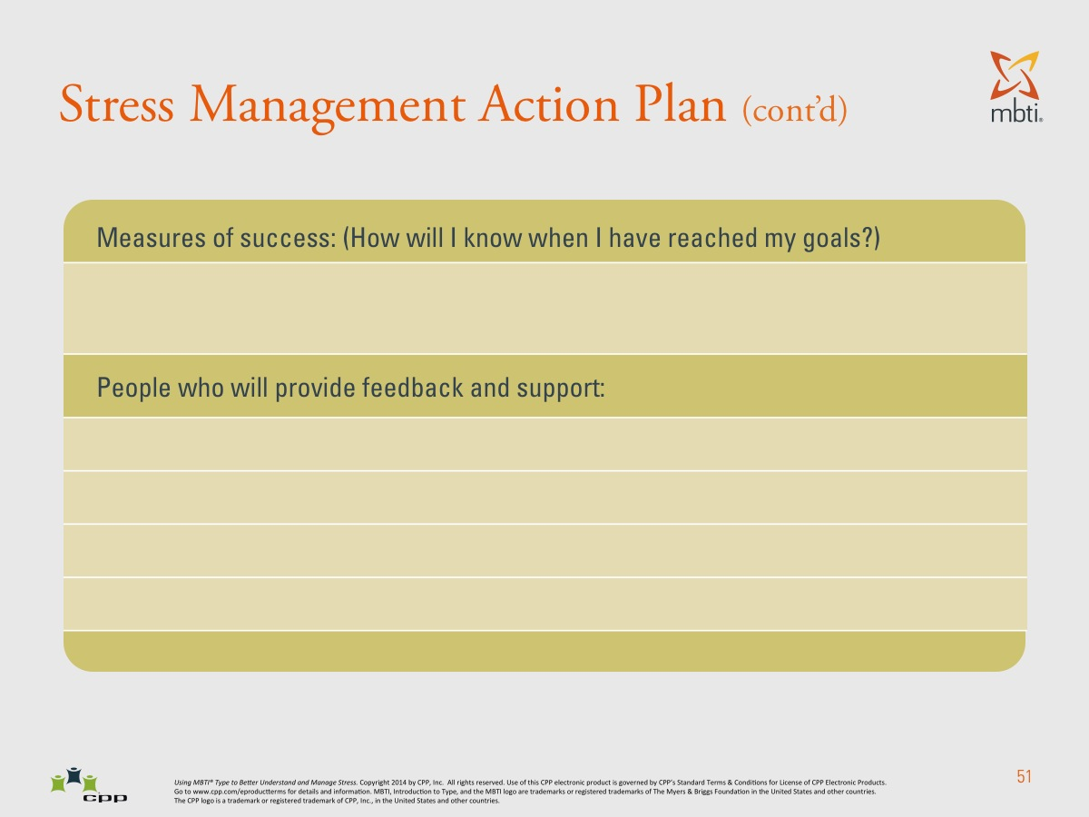

Slide 58
Wrap-Up
What did you learn about yourself as a leader and your response under stress?
What can you do differently as a result of what your learned or experienced?

Slide 59

“Leadership and learning are indispensable to each other.”
John F. Kennedy

