Slide 1


Accelerator SERIES
THE 5 VOICES
OF A TEAM

Slide 3
MBTI: Personal & Teams

Slide 4
MBTI: Personal & Teams
Emotional Intelligence

Slide 5
MBTI
Emotional Intelligence
Five Voices:
…yours?
…weapons systems/issues
…communicating vision…
…get paper and pen

Slide 6



5 VOICES
How to Communicate Effectively
with Everyone You Lead
// GiANT Worldwide

Slide 7

THE CORE
IQ
COMPETENCY
EQ
CONNECTIVITY
THE
CORE
PQ
SELF-AWARENESS
© GiANT WORLDWIDE, Source: Inspired by Travis Bradberry & Jean Greaves, Emotional Intelligence 2.0

Slide 8

DRIVERS THAT AFFECT YOUR BEHAVIOR
NATURE
LEADERSHIP
BEHAVIORS
NURTURE
CHOICE
© GiANT WORLDWIDE

Slide 9
OUGHTS AND SHOULDS OF NURTURE
ROLE MODELS
SCHOOLING
FAITH
GENDER
OUGHTS &
SHOULDS
CULTURE
SUCCESSES
PARENTING
FAILURES
AUTHORITY FIGURES
DREAMS
EARLY LIFE EXPERIENCES
© GiANT WORLDWIDE
Notes:
We may have the same Nature by wiring but we are all unique as no two individuals ever makes the same choices or grow up with the same Nurture.

Slide 10

KNOW YOURSELF TO LEAD YOURSELF
CONSEQUENCES
KNOW
YOURSELF
LEAD
YOURSELF
REALITY
ACTIONS
(PATTERNS)
TENDENCIES
© GiANT WORLDWIDE

Slide 11
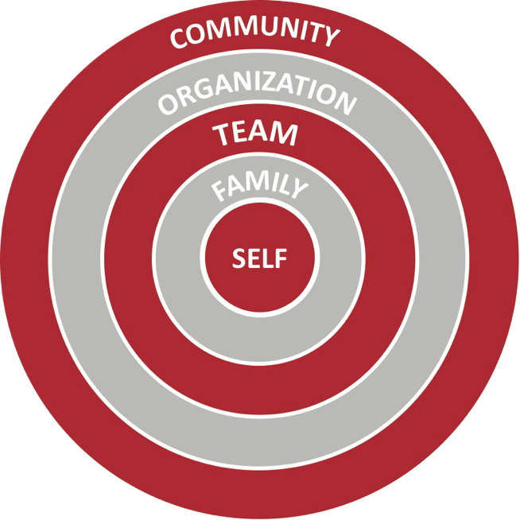
5 CIRCLES OF INFLUENCE
INTENTIONAL
ACCIDENTAL
© GiANT WORLDWIDE

Slide 12










5 VOICES
PIONEER
NURTURER
CONNECTOR
CREATIVE
GUARDIAN
© GiANT WORLDWIDE

Slide 13
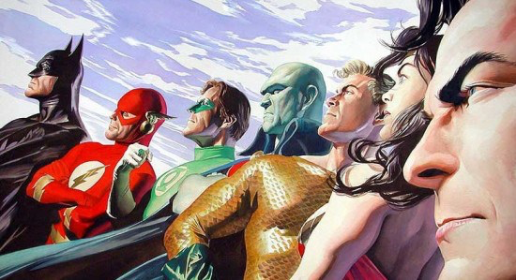

Slide 14
5 VOICES
PIONEER
NURTURER
CONNECTOR
CREATIVE
GUARDIAN
© GiANT WORLDWIDE

Slide 15
5 VOICES | ASSUMPTIONS
Our “Voice” is made up of all 5 Voices.
Some voices are more natural to us than others
Maturity allows us to value the contribution each voice brings.
Nature / Nurture and Choice have all played a part
Don’t assume you know what someone else’s foundational voice is
Don’t assume you know what each word means
© GiANT WORLDWIDE
Notes:
Walk through each of the 6 Foundational Assumptions for 5 Voices. Take the time to make sure everyone understands the framework.

Slide 16
LET’S TAKE THE
5 VOICES
ASSESSMENT

Slide 17
HOW TO RATE YOUR VOICE
GREEN
    My Foundational Voice, my default pattern of communication & thinking
YELLOW
    Not my Foundational Voice but I value it and it’s easily accessible
RED
    Not my Foundational Voice, I find it hard to value and hard to access
© GiANT WORLDWIDE
Notes:
You should all have a color rating for your current reality with each of the 5 voices. Always worth checking before moving on!!

Slide 18
NURTURER
WHAT IS A NURTURER?
  Nurturers are champions of people.
  They are always concerned about the relational health and harmony of the group.
  They are completely committed to protecting values and principles.
  Nurturers have a hard time separating their work from who they are.
  They innately understand how certain actions, behaviors, or initiatives will affect people.
© GiANT WORLDWIDE

Slide 19
NURTURER
WHAT DO THEY BRING AT THEIR BEST?
Everyone deserves to be heard - they appreciate each contribution
They intuitively feel how an organization will react to a new idea
Pragmatic realism - has this really been thought through?
They defend values - people always come before profit
Function as the relational oil inside the organization.
Commitment to relational harmony before/during / after meetings
© GiANT WORLDWIDE

Slide 20
NURTURER
WHAT QUESTIONS ARE THEY REALLY ASKING INSIDE?
  What are people going to be most upset about?
  Who is going to hate this?
  Is this really practical? Is it really going to happen?
  Has the final decision been made?
  Do they really want to hear what I think?
NEGATIVE IMPACT
Overly resistant to change & can be passive aggressive
Feel unable to challenge proposed direction when they disagree
Making money often seen as an impure motive
Don’t value the contribution they make
© GiANT WORLDWIDE

Slide 21
RATE YOUR NURTURER VOICE
GREEN
    My Foundational Voice, my default pattern of communication & thinking
YELLOW
    Not my Foundational Voice but I value it and it’s easily accessible
RED
    Not my Foundational Voice, I find it hard to value and hard to access
© GiANT WORLDWIDE
Notes:
You should all have a color rating for your current reality with each of the 5 voices. Always worth checking before moving on!!

Slide 22


PAIRS EXERCISE
Turn to the person next to you - tell them what color you have rated your Nurturer Voice and why?
© GiANT WORLDWIDE

Slide 23





FIRST VOICE PERCENTAGES
NURTURER 43%
CREATIVE
—
GUARDIAN
—
CONNECTOR
—
PIONEER
—
© GiANT WORLDWIDE

Slide 24
CREATIVE
WHAT IS A CREATIVE?
  Creatives are champions of innovation.
  They are outside the box thinkers.
  They are an “early warning radar system” that sees the opportunities and dangers of the future before everyone else.
  Creatives are never satisfied with the status quo - they always believe it can be better. The word “can’t” is not in their vocabulary.
  They ask the question: “Why do people never seem to fully understand my ideas?”
  Creatives long for an environment where they know their contribution is valued and appreciated.
  They are defenders of values and integrity.
© GiANT WORLDWIDE

Slide 25
CREATIVE
WHAT DO THEY BRING AT THEIR BEST?
Creatives see the future first - both in terms of long term opportunities and potential dangers.
They are never satisfied with good enough.
They are Conceptual Architects - able to see how all the pieces fit together.
Capacity to think outside the box
Strong social conscience and a desire for organizational integrity
© GiANT WORLDWIDE

Slide 26
CREATIVE
WHAT QUESTIONS ARE THEY REALLY ASKING INSIDE?
  So what? Does all this activity really get us nearer to delivering the big picture vision?
  Are we compromising our values in a way that we might regret later?
  Are you ready to listen to what I need to share?
  Why are we limiting ourselves? How could we do it better?
NEGATIVE IMPACT
They can often fail to celebrate the 90% that has been achieved, focusing instead on the 10% that hasn’t!
Idealism often trumps pragmatism leading to a sense of paralysis until they believe it can be perfect.
Tendency to ignore financial constraints and other practical hurdles.
© GiANT WORLDWIDE

Slide 27
RATE YOUR CREATIVE VOICE
GREEN
    My Foundational Voice, my default pattern of communication & thinking
YELLOW
    Not my Foundational Voice but I value it and it’s easily accessible
RED
    Not my Foundational Voice, I find it hard to value and hard to access
© GiANT WORLDWIDE
Notes:
You should all have a color rating for your current reality with each of the 5 voices. Always worth checking before moving on!!

Slide 28
PAIRS EXERCISE
Turn to the person next to you - tell them what color you have rated your Creative Voice and why?
© GiANT WORLDWIDE

Slide 29
FIRST VOICE PERCENTAGES
NURTURER 43%
CREATIVE
9%
GUARDIAN
—
CONNECTOR
—
PIONEER
—
© GiANT WORLDWIDE

Slide 30
GUARDIAN
WHAT IS A GUARDIAN?
  Guardians are champions of responsibility and stewardship.
  They respect and value logic, order, procedure, and process.
  They seek clarity as well as logical and proven decision-making criteria even if they have to ask the tough questions to get there!
  Guardians like to see established track records of success to justify trying something different.
  They can feel frustrated that they are sometimes seen as “raining on the parade” just because they are trying to make sure the team makes the best decision possible.
© GiANT WORLDWIDE

Slide 31
GUARDIAN
WHAT DO THEY BRING AT THEIR BEST?
Relentless commitment to ask the difficult questions.
Selfless capacity to deliver the vision once it has been agreed.
Long-term commitment to deliver on time and on budget.
Custodian of resources and how money is invested / spent.
Ability to detach decision-making from personal sentiments.
Guard what we already have that is working.
© GiANT WORLDWIDE

Slide 32
GUARDIAN
WHAT QUESTIONS ARE THEY REALLY ASKING INSIDE?
  Is it worth the risk and investment?
  Convince me that change is really necessary.
  Can we test the hypothesis before we go all in?
  Am I at risk of being taken advantage of?
  Are we honoring the past as we look towards the future?
NEGATIVE IMPACT
Inability to compromise when they have a strongly held opinion.
Desire for truth & right decisions override feelings of others.
Can appear overly critical of people and ideas.
Tone and Tact .
© GiANT WORLDWIDE

Slide 33
RATE YOUR GUARDIAN VOICE
GREEN
    My Foundational Voice, my default pattern of communication & thinking
YELLOW
    Not my Foundational Voice but I value it and it’s easily accessible
RED
    Not my Foundational Voice, I find it hard to value and hard to access
© GiANT WORLDWIDE
Notes:
You should all have a color rating for your current reality with each of the 5 voices. Always worth checking before moving on!!

Slide 34
PAIRS EXERCISE
Turn to the person next to you - tell them what color you have rated your Guardian Voice and why?
© GiANT WORLDWIDE

Slide 35
FIRST VOICE PERCENTAGES
NURTURER 43%
CREATIVE
9%
GUARDIAN
30%
CONNECTOR
—
PIONEER
—
© GiANT WORLDWIDE

Slide 36
CONNECTOR
WHAT IS A CONNECTOR?
  Champion of relationships and strategic partnerships.
  Connectors rally people to causes and things they believe in.
  Connectors believe in a world where everyone can play and get excited about future opportunities…and they want to make it happen!
  Receiving appreciation and credit for making key connections is highly motivating and energizing for Connectors.
  Connectors often respond to challenges with: “Whatever we need, I can get it or I have a source.”
© GiANT WORLDWIDE

Slide 37
CONNECTOR
WHAT DO THEY BRING AT THEIR BEST?
Capacity to maintain a large number of relationships
They know how to connect with people & their aspirations
Boundless Creativity, Energy & Imagination
Connections to new opportunities and networks
Persuasive and inspirational communication
© GiANT WORLDWIDE

Slide 38
CONNECTOR
WHAT QUESTIONS ARE THEY REALLY ASKING INSIDE?
  What will make this idea connect with people?
  You really can’t “see it”?
  Is everyone still with me?
  Are you aware of what I’ve done?
NEGATIVE IMPACT
People pleasing tendencies means they struggle to bring challenge
When they feel critiqued they sell harder
They don’t hear or engage fully with critical feedback
They hijack the conversation and bring it back to being about them
Passive aggression & withdrawal after their idea is rejected
© GiANT WORLDWIDE

Slide 39
RATE YOUR CONNECTOR VOICE
GREEN
    My Foundational Voice, my default pattern of communication & thinking
YELLOW
    Not my Foundational Voice but I value it and it’s easily accessible
RED
    Not my Foundational Voice, I find it hard to value and hard to access
© GiANT WORLDWIDE
Notes:
You should all have a color rating for your current reality with each of the 5 voices. Always worth checking before moving on!!

Slide 40
PAIRS EXERCISE
Turn to the person next to you - tell them what color you have rated your Connector Voice and why?
© GiANT WORLDWIDE

Slide 41
FIRST VOICE PERCENTAGES
NURTURER 43%
CREATIVE
9%
GUARDIAN
30%
CONNECTOR
11%
PIONEER
—
© GiANT WORLDWIDE

Slide 42
PIONEER
WHAT IS A PIONEER?
  Pioneers are champions of change and ingenuity.
  They approach life with an “Anything is possible!” attitude.
  Pioneers believe visioning a new future is always the highest priority.
  They are always seeking to find the quickest, fastest, and most efficient way to do things.
  Pioneers value “outside the box thinking,” interesting or different ways of doing things, and tend to seek out the most interesting people to learn from and add to their body of knowledge.
© GiANT WORLDWIDE

Slide 43
PIONEER
WHAT DO THEY BRING AT THEIR BEST?
Strategic military thinking to achieve the agreed objective
Courage to make difficult decisions and prioritize the vision
Communicate an attractive vision of the future
Capacity to align resources and people to make things happen
Tenacity, energy and a strong desire for the team to win
© GiANT WORLDWIDE
Notes:
So let’s look first at the Pioneer voice in a team context.
Use the statements to bring the voice to life for your audience in the context of a team environment.
Don’t worry - The statements have been road tested so even if you read them they will work!
It’s important that we highlight the contribution each voice brings at its best. This is one of the key learnings from the 5 Voices lens, leaders need to create environments where all voices are able to contribute their best.
Work hard at the voices that are less familiar to you - make sure you can see the validity of their contribution. We are all biased to our own personal preferences.

Slide 44
PIONEER
WHAT QUESTIONS ARE THEY REALLY ASKING INSIDE?
  Who says we can’t?
  Do you really not “get it”?
  Are you competent?
  Have you got a proven track record?
NEGATIVE IMPACT
They appear arrogant with a “Me Focused” Agenda
They fail to hear or value all of the 5 Voices
Quickly get frustrated with those who don’t “get it”
“Back me or fight me!” when they present their ideas
Driving to hard with an insensitivity to the needs of others
© GiANT WORLDWIDE
Notes:
Having been through the 4 sections ask everyone to give that voice a color - A color that reflects their current familiarity with it. It’s worth explaining the difference between Green / Yellow / Red again.

Slide 45
RATE YOUR PIONEER VOICE
GREEN
    My Foundational Voice, my default pattern of communication & thinking
YELLOW
    Not my Foundational Voice but I value it and it’s easily accessible
RED
    Not my Foundational Voice, I find it hard to value and hard to access
© GiANT WORLDWIDE
Notes:
You should all have a color rating for your current reality with each of the 5 voices. Always worth checking before moving on!!

Slide 46
PAIRS EXERCISE
Turn to the person next to you - tell them what color you have rated your Pioneer Voice and why?
© GiANT WORLDWIDE

Slide 47
FIRST VOICE PERCENTAGES
NURTURER 43%
CREATIVE
9%
GUARDIAN
30%
CONNECTOR
11%
PIONEER
7%
© GiANT WORLDWIDE

Slide 48
Champion of…
NURTURER
Relational Harmony, Values, and People
© GiANT WORLDWIDE

Slide 49
Champion of…
CREATIVE
Future ideas, Organizational Integrity, and Social Conscience
© GiANT WORLDWIDE

Slide 50
Champion of…
GUARDIAN
Truth, Stewardship of Money and Systems
© GiANT WORLDWIDE

Slide 51
Champion of…
CONNECTOR
Relational Networks, Branding and Messaging, and Internal Collaboration
© GiANT WORLDWIDE

Slide 52
Champion of…
PIONEER
Strategic Vision, Tough Decisions, and Problem solving
© GiANT WORLDWIDE

Slide 53
CHAMPION OF…
Nurturer - Relational harmony, Values and People
Creative - Future ideas, Organizational Integrity and Social Conscience
Guardian - Truth, Stewardship of Money and Systems
Connector - Relational Networks, Branding and Messaging and Internal Collaboration
Pioneer - Strategic Vision, Tough Decisions and Problem solving
© GiANT WORLDWIDE

Slide 54

Weapon Systems?
© GiANT WORLDWIDE

Slide 55
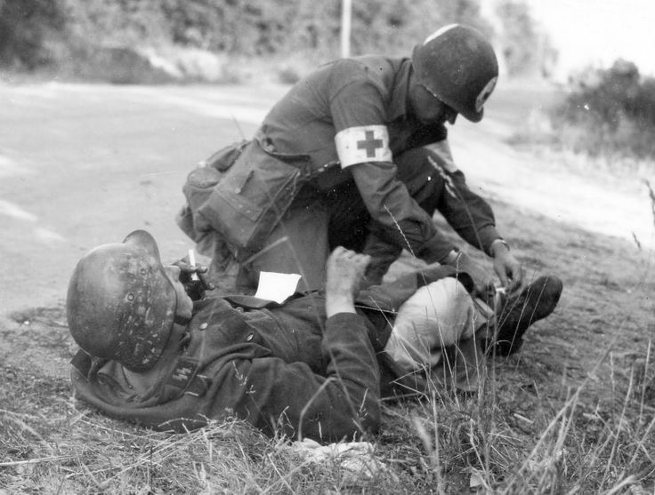
NURTURER
© GiANT WORLDWIDE

Slide 56

CREATIVE (F)
© GiANT WORLDWIDE

Slide 57

CREATIVE (T)
© GiANT WORLDWIDE

Slide 58
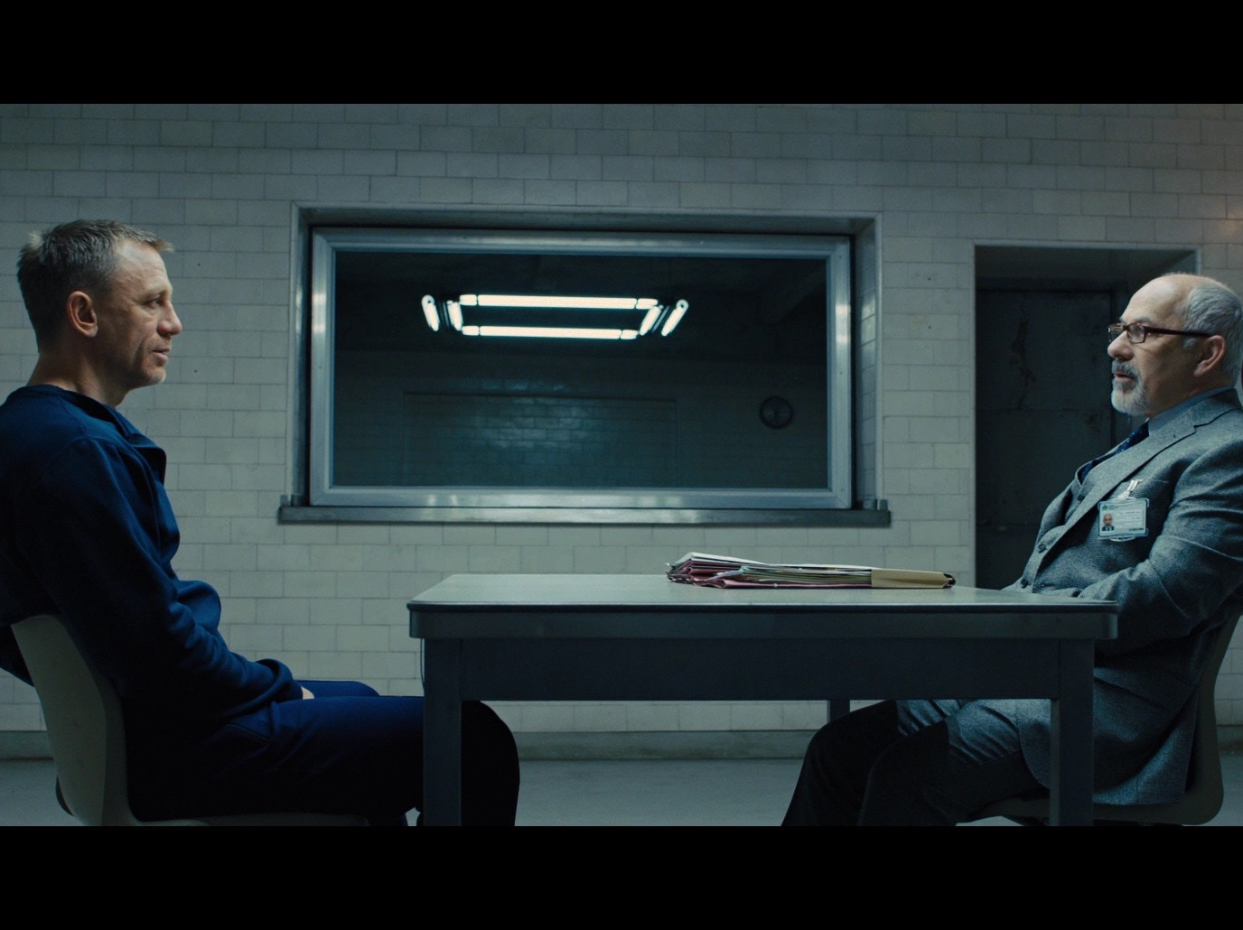
GUARDIAN
© GiANT WORLDWIDE

Slide 59

cyber warfare
CONNECTOR
© GiANT WORLDWIDE

Slide 60
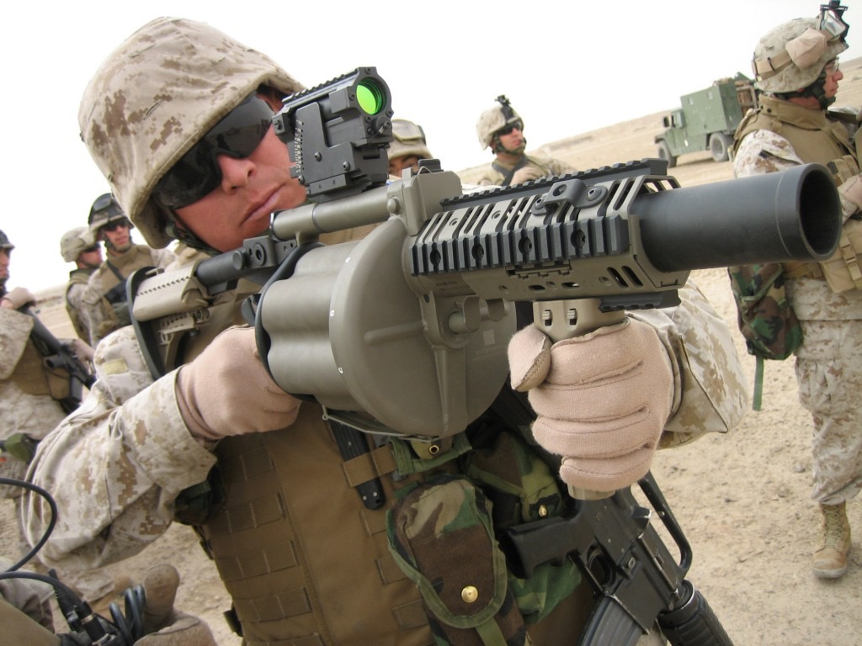
PIONEER
© GiANT WORLDWIDE

Slide 61
YOUR VOICES
ORDER YOUR NATURAL VOICES 1 - 5
Using your answers to these question, order each of the 5 voices from 1 to 5 according to which one you believe is most natural to you (1) down to which is most unnatural (5).
1. __________________
2. __________________
3. __________________
4. __________________
5. __________________
© GiANT WORLDWIDE
Notes:
Now I want you to rank them -
Is the voice that is most natural for you
5) Is the most unnatural for you.
Personal reflection - What have been the big aha’s in completing this exercise?
Intimate Space - Take a moment to share your rank order with the person next to you. Also explain to them what the big aha’s have been for you.
Allow the conversations to develop - then having regathered the group ask for any personal insights have been particularly revealing.
Remind them of their GiANT Best Fit Experience - The next slide shows how your NATURE alone would have influenced your Foundational Voice, or number 1) in the ranking exercise.

Slide 62
LEADERSHIP
INSIGHTS
© GiANT WORLDWIDE

Slide 63

NATURE - FOUNDATIONAL VOICES
ISTJ GUARDIAN | ISFJ NURTURER | INFJ CREATIVE | INTJ PIONEER
ISTP GUARDIAN | ISFP NURTURER | INFP CREATIVE | INTP CREATIVE
ESTP GUARDIAN | ESFP NURTURER | ENFP CONNECTOR | ENTP PIONEER
ESTJ GUARDIAN | ESFJ NURTURER | ENFJ CONNECTOR | ENTJ PIONEER
© GiANT WORLDWIDE
Notes:
Most people will have a direct correlation, there will invariably be one or two who don’t. Highlight the following slide that shows our behaviors are not purely driven by our Nature - Nurture and Choices play a significant part in the voices we believe we are allowed to speak. Oughts and Should’s are very real here!
Explain that the following table shows how NATURE alone would rank the 5 Voices.

Slide 64
5 VOICES| NATURE PREDICTIONS from GiANT Best Fit
If left to NATURE alone this is the rank order we would expect
GBFE Type | Nurturer | Guardian | Creative | Connector | Pioneer
ISTJ | 2 | 1 | 4 | 5 | 3
ISFJ | 1 | 2 | 4 | 3 | 5
ISTP | 3 | 1 | 4 | 5 | 2
ISFP | 1 | 4 | 2 | 3 | 5
ESTJ | 3 | 1 | 5 | 4 | 2
ESFJ | 1 | 3 | 4 | 2 | 5
ESTP | 2 | 1 | 5 | 4 | 3
ESFP | 1 | 2 | 3 | 4 | 5
INTJ | 5 | 4 | 2 | 3 | 1
INFJ | 4 | 5 | 1 | 2 | 3
INTP | 5 | 3 | 1 | 4 | 2
INFP | 3 | 5 | 1 | 2 | 4
ENTJ | 5 | 2 | 3 | 4 | 1
ENFJ | 4 | 5 | 2 | 1 | 3
ENTP | 5 | 4 | 3 | 2 | 1
ENFP | 4 | 5 | 2 | 1 | 3
© GiANT WORLDWIDE
Notes:
Give them a chance to find their MBTI type and note the Rank order and Color of each voice. This is the hand they were dealt at the start of the lives. These colors don’t define your current reality! NURTURE and CHOICES have hopefully caused us to grow and mature!

Slide 65
5 VOICES - SUMMARY TABLE
Voice | Rank Order | Nature
Nurturer
Creative
Guardian
Connector
Pioneer
Notes:
Give everyone time to transpose their data on to the Master Table. Take time to explain where each piece of information comes from.
Once they have completed the first 3 columns you should give them time to reflect on the outcomes and how NURTURE and CHOICE have played their parts.
Give the following examples -
A ENFP who has worked as a CPA or Attorney is likely to rank higher on Guardian voice than their NATURE Predictions.
A female ENTJ who has spent the last 12 years raising children will rank higher on NURTURER.
A ISTP who has run their own business for 10 years will rank higher on PIONEER.
A female ENTP who grew up in a strict religious family may not rank highly as a PIONEER.
We are all a complex mix of NATURE / NURTURE / CHOICE - This tool simply helps you ask good questions. Ultimately the more we know ourselves the more we can choose how we engage with others in a team.
Personal Reflection - When you look at the table can you understand how your NURTURE and CHOICES have impacted things.
Intimate Space - Take time to share your insights with 1 or 2 others. This process engages their own critical faculties and makes the learning more concrete for them.
Live Trouble Shooting - There will always be a couple of participants who are confused. Take them one at a time, discern what the real issue is and ask about their background, career choice etc. You are not trying to fix someone, but in my experience most of the significant variances are very predictable. In the end we are helping people make sense of their leadership journey and become more self aware.

Slide 66
SELECT TWO LEADERSHIP INSIGHTS - NURTURERS
When you speak you represent 43% of people. Your views and opinion and truly matter!
People see you as a highly skilled professional. It’s time you started to believe that!
People chose you to lead because they believe in you. Act knowing that you belong!
Learn to challenge the views of other voices in your team when you believe they are wrong!
Embrace change and help lead it. Don’t be passive and function as a victim of it.
People trust your judgment and genuinely want to hear your opinion. Use that as a springboard for influence, and speak the truth in love.
When people challenge your views and opinions they are trying to help. It’s not a personal attack!
Pioneers are not as insensitive and arrogant as you think. They just see the world differently to you!
© GiANT WORLDWIDE

Slide 67
SELECT TWO LEADERSHIP INSIGHTS - CREATIVES
Learn to celebrate the wins even if it wasn’t quite as perfect as you hoped.
When members of your team critique your vision and ask for the details they are genuinely trying to help.
Don’t play safe, give yourself permission to think outside the box.
It’s ok to be wrong sometimes, it comes with the territory of creativity and imagination.
What you see as an imminent opportunity or threat may actually be a further away than you think.
Financial realities are important, good enough may have to be good enough sometimes.
People are not deliberately ignoring your ideas, it’s hard to truly hear a Creative.
You don’t have to prove your worth to team mates, relax and trust the unique contribution you bring.
© GiANT WORLDWIDE

Slide 68
SELECT TWO LEADERSHIP INSIGHTS - GUARDIANS
How you communicate is important (volume and sensitivity) - It’s possible for you be right and wrong at the same time.
Learn to value the future orientated voices, they drive innovation and progress.
Sometimes goal posts move on projects and it’s not anyone’s fault.
Learning to compromise is a healthy part of team life.
Be careful, constantly driving yourself and your team will eventually lead to burnout and resentment.
Take time to invest in your key relationships today, you are not defined by task achievement alone.
Your team know you are competent, do they know you care?
Networking events and social media platforms are not a waste of time.
© GiANT WORLDWIDE

Slide 69
SELECT TWO LEADERSHIP INSIGHTS - CONNECTORS
When people reject your idea it’s not as personal as it sometimes feels.
Hinting at your frustrations with team mates does not guarantee anyone has truly heard you.
People will critique your ideas, try and avoid becoming overly defensive too soon.
It’s ok to be you - when you believe something passionately never be afraid to share it.
When you speak complete your sentences and stay focussed on one idea at a time.
Be consistent in your external communication, avoid the temptation to sell to individuals ahead of the meeting.
Be Intentional - take time to think through how you can create a culture where other voices can bring their best.
Be patient with those whose due diligence process is rigorous, painful and time consuming.
© GiANT WORLDWIDE

Slide 70
SELECT TWO LEADERSHIP INSIGHTS - PIONEERS
Beware the intellectual superiority complex, you don’t have all the best ideas, sometimes you are actually wrong.
Take time to truly hear the views and opinions of others on the team, memorize the rules of engagement.
Please make sure your safety catch is always on, in a moment of frustration you can do a lot of damage with a grenade launcher.
Only 7% of people view the world through your eyes - remember winning is not the driving motivation for most people.
Your team know you are competent, they are not convinced you know anything about them or their life outside of work.
Find a Nurturer and ask them to mentor you in how they see the world.
Take time each day to encourage someone who doesn’t deserve it.
If you are wrong, fight your initial instinct to justify your decision and deflect blame. You will earn respect and influence if you own up to your mistakes.
© GiANT WORLDWIDE

Slide 71

CORE EXERCISE:
Instructions
Consider your contribution in a team environment.
What is the big “Aha” for your Voice right now?
Share your learning opportunity with the person next to you. Use the CORE Process tool to help your partner develop an appropriate Response.
CALL IT
WHAT IS MY LEARNING
OPPORTUNITY?
KNOW YOURSELF
OWN IT
RESPONSE
EXECUTE
© GiANT WORLDWIDE
LEAD YOURSELF

Slide 72
5 VOICES
PIONEER
NURTURER
CONNECTOR
CREATIVE
GUARDIAN
© GiANT WORLDWIDE

Slide 73
RULES OF TEAM ENGAGEMENT
NURTURER
We want to hear your opinion
No one is going to critique immediately
CREATIVE
Dream big - It’s ok to be wrong sometimes
We promise to ask clarifying questions
© GiANT WORLDWIDE
Notes:
Now I want you to rank them -
Is the voice that is most natural for you
5) Is the most unnatural for you.
Personal reflection - What have been the big aha’s in completing this exercise?
Intimate Space - Take a moment to share your rank order with the person next to you. Also explain to them what the big aha’s have been for you.
Allow the conversations to develop - then having regathered the group ask for any personal insights have been particularly revealing.
Remind them of their GiANT Best Fit Experience - The next slide shows how your NATURE alone would have influenced your Foundational Voice, or number 1) in the ranking exercise.

Slide 74
RULES OF TEAM ENGAGEMENT
GUARDIAN
Keep asking the difficult questions
We promise to stay engaged as long as we can
CONNECTOR
Sell your ideas as passionately as you can
When we critique them it’s not personal
© GiANT WORLDWIDE
Notes:
Now I want you to rank them -
Is the voice that is most natural for you
5) Is the most unnatural for you.
Personal reflection - What have been the big aha’s in completing this exercise?
Intimate Space - Take a moment to share your rank order with the person next to you. Also explain to them what the big aha’s have been for you.
Allow the conversations to develop - then having regathered the group ask for any personal insights have been particularly revealing.
Remind them of their GiANT Best Fit Experience - The next slide shows how your NATURE alone would have influenced your Foundational Voice, or number 1) in the ranking exercise.

Slide 75
RULES OF TEAM ENGAGEMENT
PIONEER
Please listen to everyone else’s view first
Beware the strength of your critique
© GiANT WORLDWIDE
Notes:
Now I want you to rank them -
Is the voice that is most natural for you
5) Is the most unnatural for you.
Personal reflection - What have been the big aha’s in completing this exercise?
Intimate Space - Take a moment to share your rank order with the person next to you. Also explain to them what the big aha’s have been for you.
Allow the conversations to develop - then having regathered the group ask for any personal insights have been particularly revealing.
Remind them of their GiANT Best Fit Experience - The next slide shows how your NATURE alone would have influenced your Foundational Voice, or number 1) in the ranking exercise.

Slide 76
SUPPORT CHALLENGE MATRIX
High Support
PROTECTOR
Culture of Entitlement
and Mistrust
LIBERATOR
Culture of Empowerment
and Opportunity
Low Challenge
High Challenge
ABDICATOR
Culture of Apathy
and Low Expectation
DOMINATOR
Culture of Fear
and Manipulation
Low Support
© GiANT WORLDWIDE

Slide 77

AHA’s!
Your 5th Voice by Nature is your Conscious Incompetence!
© GiANT WORLDWIDE

Slide 78
AHA’s!
Your 4th Voice by Nature is often your Unconscious Incompetence!
© GiANT WORLDWIDE

Slide 79
COMMUNICATING VISION
& LEADING EFFECTIVE CHANGE
© GiANT WORLDWIDE

Slide 80
THE CORE
IQ
COMPETENCY
EQ
CONNECTIVITY
THE
CORE
PQ
SELF-AWARENESS
© GiANT WORLDWIDE, Source: Inspired by Travis Bradberry & Jean Greaves, Emotional Intelligence 2.0

Slide 81

TALK OUT LOUD
Which voices do you think make the most effective communicators? Why?
© GiANT WORLDWIDE

Slide 82

COMMUNICATING VISION
Creative
Pioneer
Connector
Guardian & Nurturer
2.5%
13.5%
34%
34%
16%
Innovators
Early
Adopters
Early
Majority
Late
Majority
Laggards
© GiANT WORLDWIDE, Source Credit: E. Rogers, Diffusion of Innovations (1962)

Slide 83
COMMUNICATION EFFECTIVENESS
NURTURER 59%
CREATIVE
16%
GUARDIAN
59%
CONNECTOR
47.5%
PIONEER
31.75%
© GiANT WORLDWIDE

Slide 84
AHA!
Most Leaders are less effective communicators than they think!
© GiANT WORLDWIDE

Slide 85
The GiANT Model for LEADING EFFECTIVE CHANGE
IDEAL
GUARDIAN
NURTURER
CONNECTOR
PIONEER
CREATIVE
ADVISORY GROUP
GUARDIAN
NURTURER
KEY NURTURERS
KEY CONNECTORS
KEY GUARDIANS
PIONEER
SUCCESS
CREATIVE
GUARDIAN
NURTURER
CONNECTOR
PIONEER
FAILURE
CREATIVE
© GiANT WORLDWIDE

Slide 86
CORE EXERCISE:
Instructions
Consider the GiANT Model for Leading Effective Change
What is the big “Aha” for you right now?
Who could you invite to be part of your Advisory Group?
Share your learning opportunity with the person next to you. Use the CORE Process tool to help your partner develop an appropriate Response.
CALL IT
WHAT IS MY LEARNING
OPPORTUNITY?
KNOW YOURSELF
OWN IT
RESPONSE
EXECUTE
© GiANT WORLDWIDE
LEAD YOURSELF

Slide 87




BUILD THE BRIDGE
“If the vision is compelling,
we will find a way.”
“The vision may be compelling but
without a bridge I’m not coming.”
PIONEER
CREATIVE
CONNECTOR
GUARDIAN
NURTURER
© GiANT WORLDWIDE

Slide 88

GROUP EXERCISE 1
Nurturers and Guardians
(In groups of 4 or 5)
What practical advice would you offer Creatives, Pioneers and Connectors as they seek to“Build the Bridge” for Nurturers and Guardians?
© GiANT WORLDWIDE

Slide 89
GROUP EXERCISE 2
Pioneers, Connectors, Creatives
(In Groups of 4 or 5)
What practical advice would you offer Nurturers and Guardians as they seek to lead Creatives, Pioneers, and Connectors?
© GiANT WORLDWIDE

Slide 90
5 VOICES | Build the Bridge for Nurturers & Guardians
Apologize! acknowledge your own tendencies
Empower others to communicate the vision
Take the time to develop long-term relational trust
Remain sensitive to the pace of change
Don’t press the gas, help them take their foot off the brake
Run a pilot project wherever possible
Value and affirm the contributions they bring
© GiANT WORLDWIDE

Slide 91
5 VOICES | Leading Creatives, pioneers and connectors
Apologize! acknowledge your own tendencies
Don’t be intimidated - lead in your own identity
Clarify expectations but avoid micro management
Use venture capital principles to stay ahead
Ask - “If you were CEO what would you change?”
Learn how to harness their energy and expertise
© GiANT WORLDWIDE

Slide 92
KNOW YOURSELF TO LEAD YOURSELF
CONSEQUENCES
KNOW
YOURSELF
LEAD
YOURSELF
REALITY
ACTIONS
(PATTERNS)
TENDENCIES
© GiANT WORLDWIDE

Slide 93
5 CIRCLES OF INFLUENCE
INTENTIONAL
ACCIDENTAL
© GiANT WORLDWIDE

Slide 94
SUPPORT CHALLENGE MATRIX
High Support
PROTECTOR
Culture of Entitlement
and Mistrust
LIBERATOR
Culture of Empowerment
and Opportunity
Low Challenge
High Challenge
ABDICATOR
Culture of Apathy
and Low Expectation
DOMINATOR
Culture of Fear
and Manipulation
Low Support
© GiANT WORLDWIDE

Slide 95
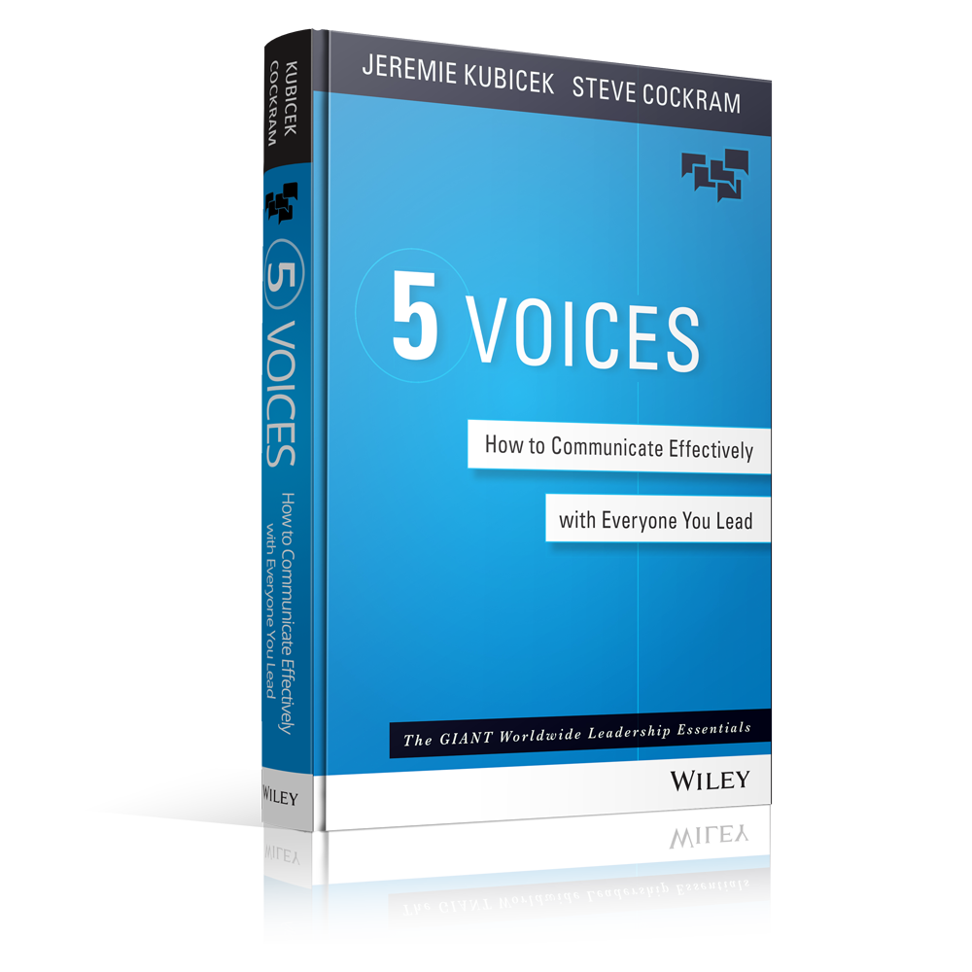
5 VOICES BOOK
5VOICES.COM
© GiANT WORLDWIDE

Slide 96
FREE LEADERSHIP COURSES
COURSES.GIANTWORLDWIDE.COM

Slide 97
